Slide 1
Ohio University Experience Day
Hearing, Speech, and Language Sciences (HSLS) Program Overview

Slide 2

What is “Hearing, Speech, and Language Sciences" (BSHSLS)?
Hearing, Speech, and Language Sciences (HSLS) is an undergraduate major within the School of Rehabilitation Studies.
Curriculum includes interdisciplinary coursework providing education of human communication processes, development, and speech & hearing sciences.

Slide 3
What courses will I take?
General Courses Include:
Biology
Statistics
Physics OR Chemistry
Intro to Special Education
Child Development
Anthropology
Public Speaking
Psychology
…..and more!
HSLS Related Courses Include:
Intro to HSLS
Phonetics
American Sign Language
Anatomy & Physiology of HSLS
Speech Science
Hearing Science
Language Development
Intro to Research in HSLS
…..and more!

Slide 4
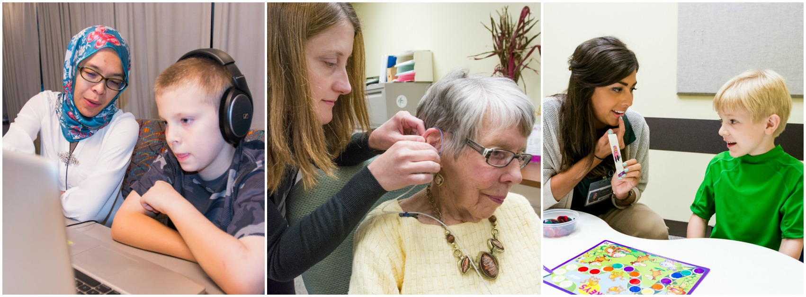
What can I do with my BSHSLS after graduation?
The typical route for HSLS undergraduates is to go to graduate school for either speech language pathology or audiology. However, some graduates have chosen other paths such as research, education, and much more!

Slide 5


What is special about our program?
Learning Communities
Upon scheduling for classes, students have the opportunity to enter a HSLS learning community. Students take common courses together and develop relationships with peers who have the same interests.
American Sign Language Program
Students have the opportunity to take up to 6 ASL classes, Deaf community, Deaf culture, and ASL Development. In fact, the first two ASL classes are required. A majority of the ASL faculty are culturally Deaf and members of the Deaf community.

Slide 6
Do you have any HSLS related research experiences?
The faculty members of the Division of HEARING, SPEECH, AND LANGUAGE SCIENCES have an array of professional interests, and many have labs that are geared toward those interests. From an auditory electrophysiology to child language and dysphagia to speech-processing, there may be a lab to fit a prospective student or client's needs.
Students may become involved in research by participating in ongoing studies, working in a faculty member's lab, taking the intro to research class, and even starting their own research project!

Slide 7
Can I study a minor with my HSLS major?
Yes! In fact, the HSLS program has leniency within the curriculum so a minor or certificate is easily accomplishable and sometimes even satisfy some HSLS requirements. Some common minors and certificates within HSLS include...
Psychology
Gerontology
Community and Public Health
Communications
Professional Deaf Resources Liaison
Business
Linguistics

Slide 8
Can I have a job and go to school at the same time?
Yes! Finding a part-time job is easy. There are student employment opportunities all over the University. Popular places include....
Culinary Services
Transportation & Parking
Student Affairs
Heritage College of Osteopathic Medicine
Job listings become available regularly throughout the semester on the Ohio University jobs website.

Slide 9



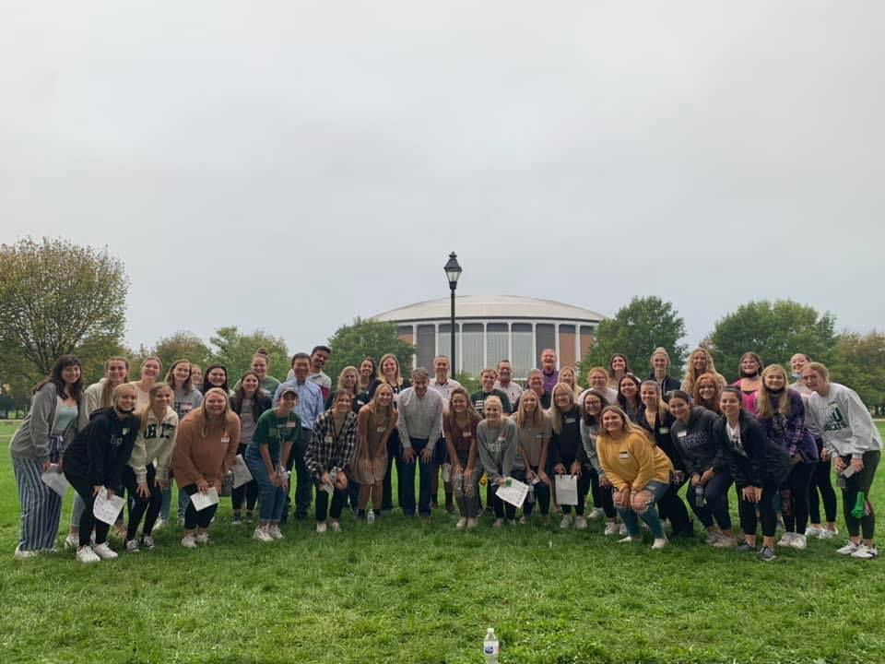
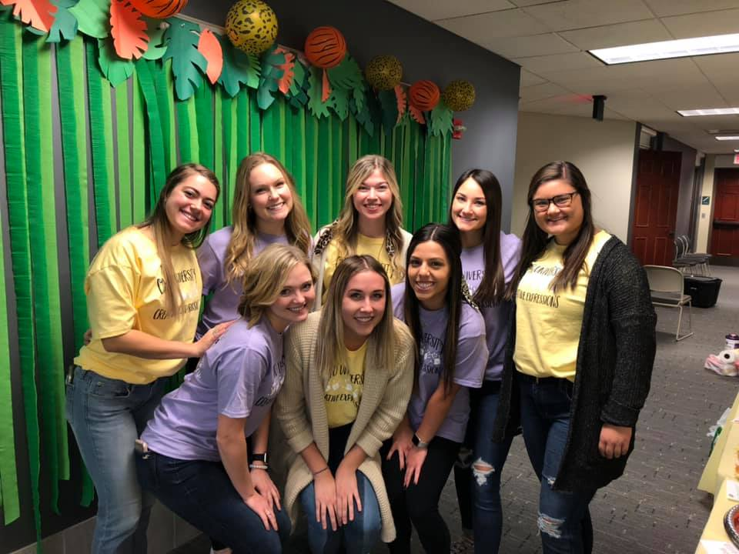
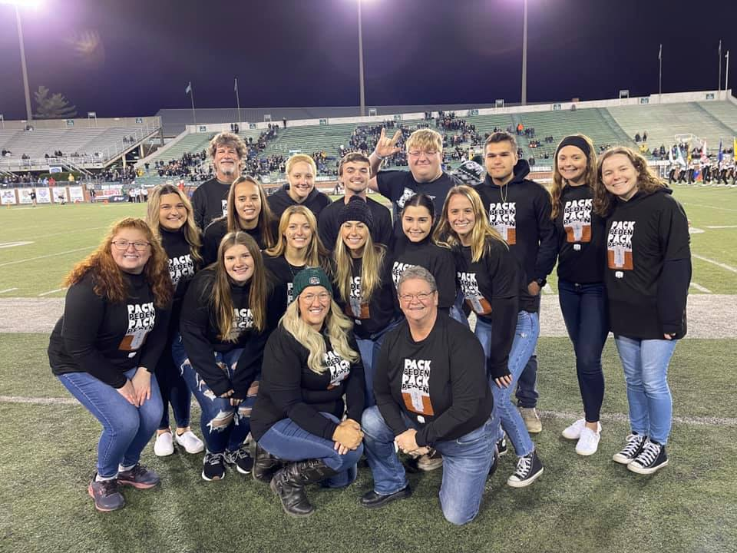
How can I get involved?
Ohio University has a club for every person and every hobby! Some HSLS related organizations include...

Slide 10
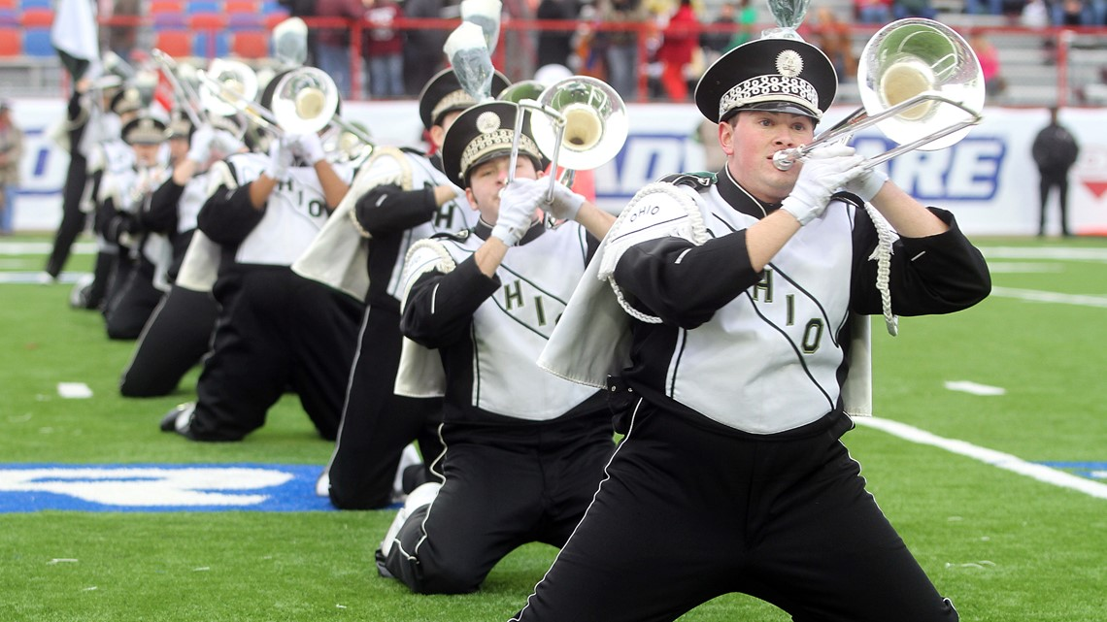
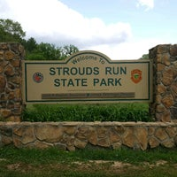
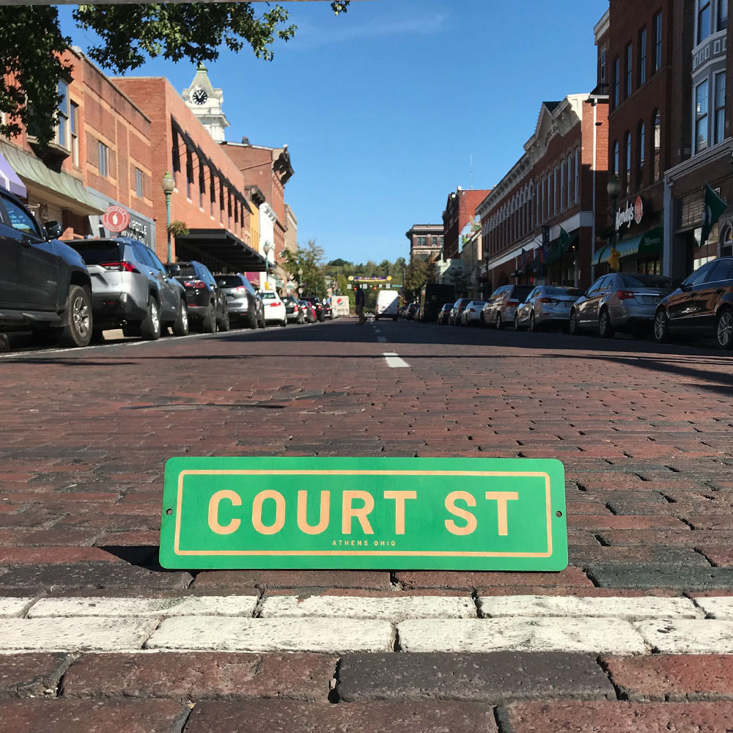



Life in Athens
Athens is a small community but is incredibly diverse! There is something for everyone from food to hiking. Some of our favorites include...

Slide 11
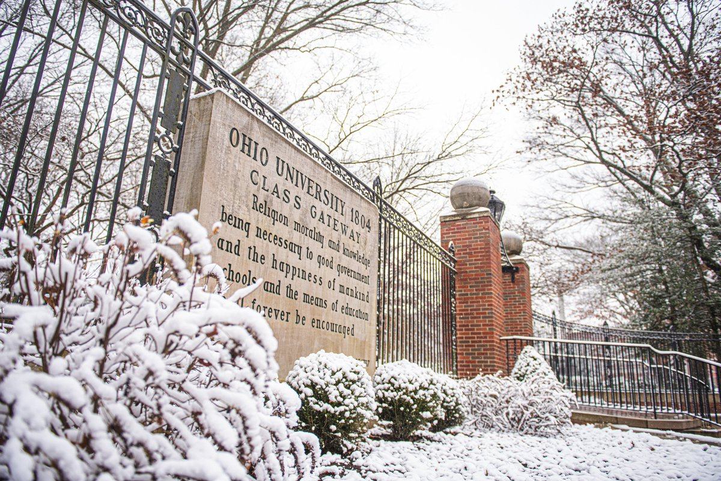
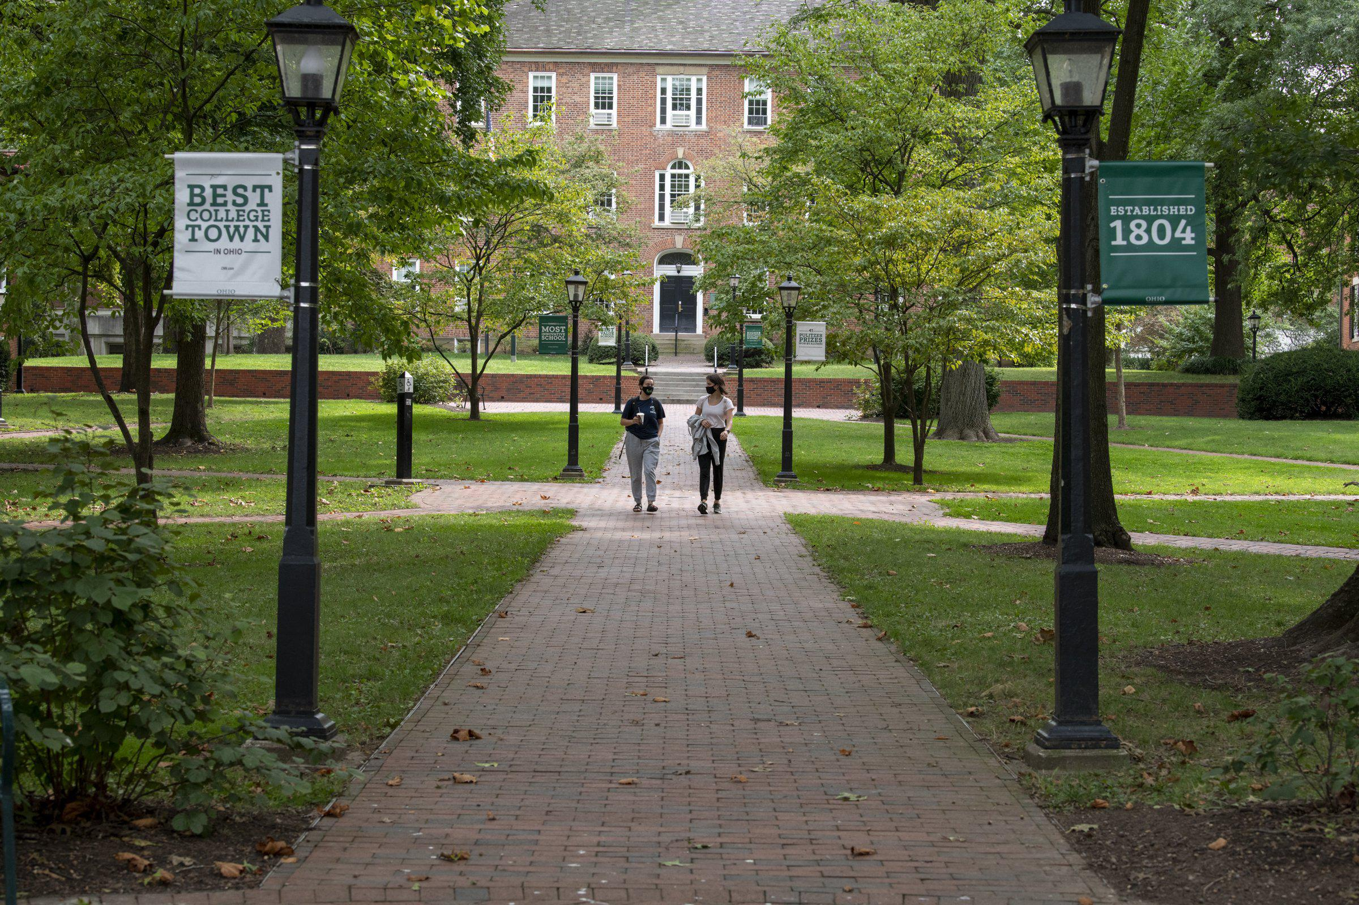
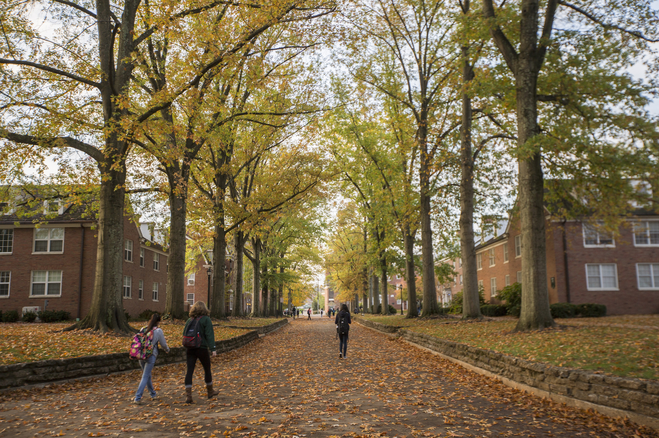
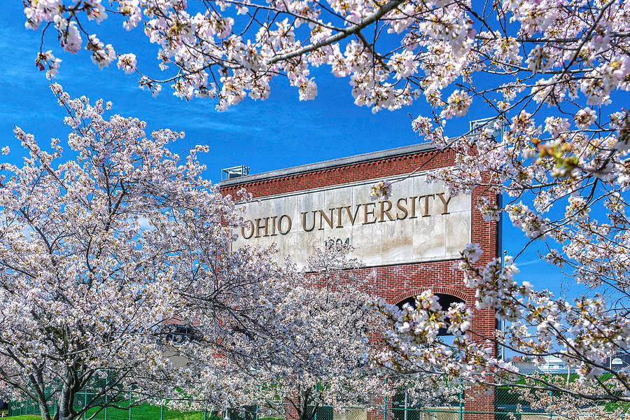
Enjoy the Beauty of our Campus... Year-Round!

Slide 12
Tips from the Pros (Current Students)
Don't overload yourself with too many difficult courses at one time
Go to PAL sessions if you can
Find a study method that works for you and find peers to study with
Make time for yourself & things that you love
Get involved! Join a club...or two...or three
Find people with the same interests as you
Make good relationships with professors – they support you more than you know!

Slide 13
Questions?

Slide 14
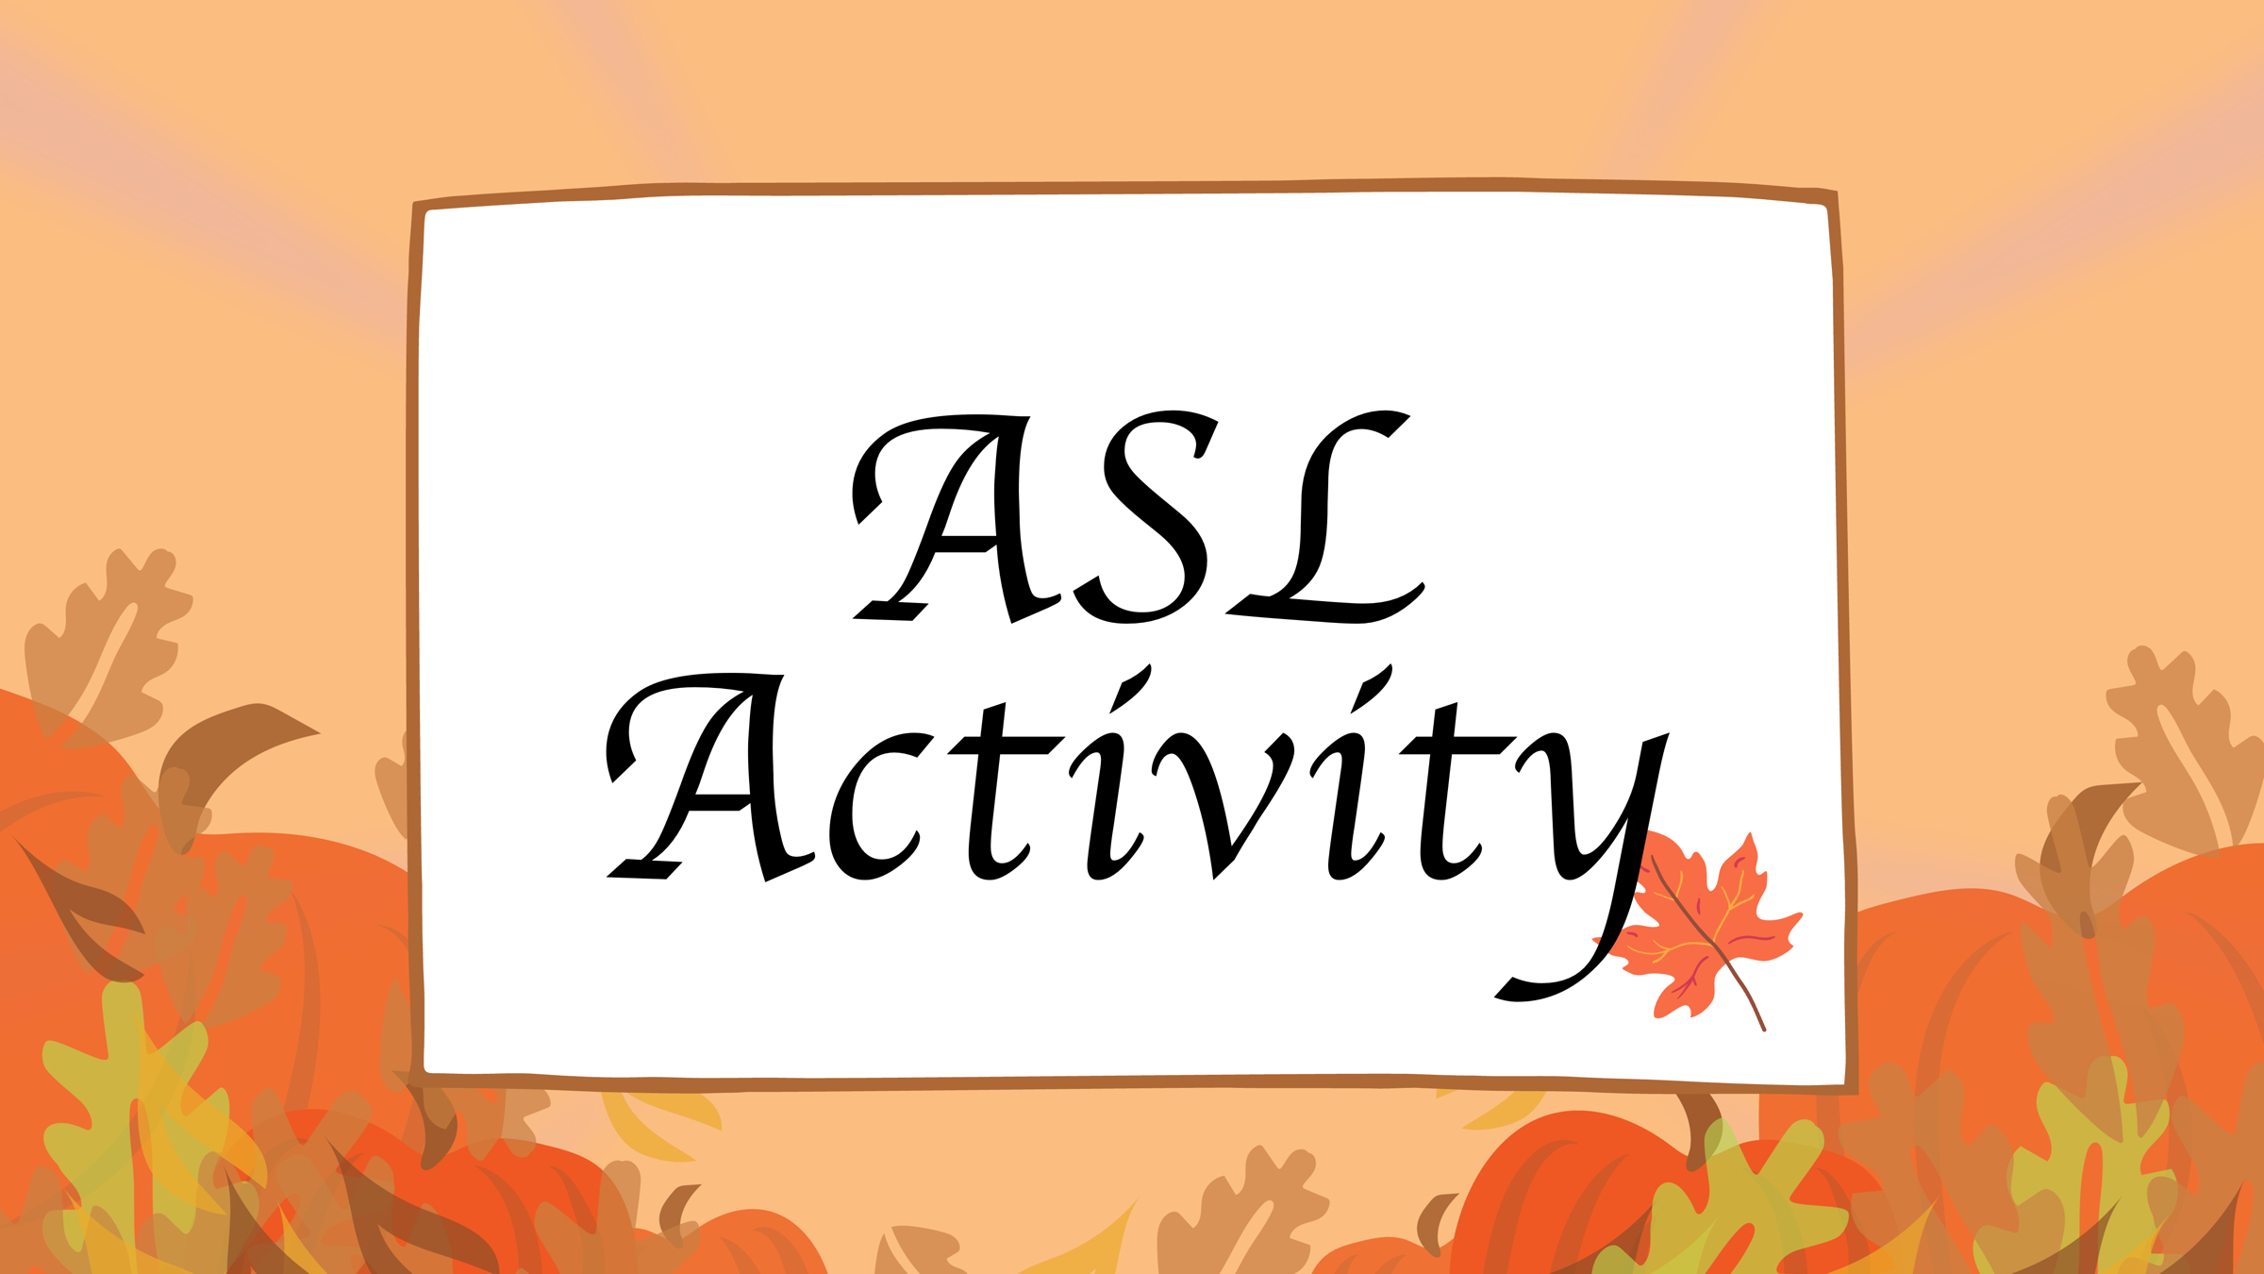

Slide 15
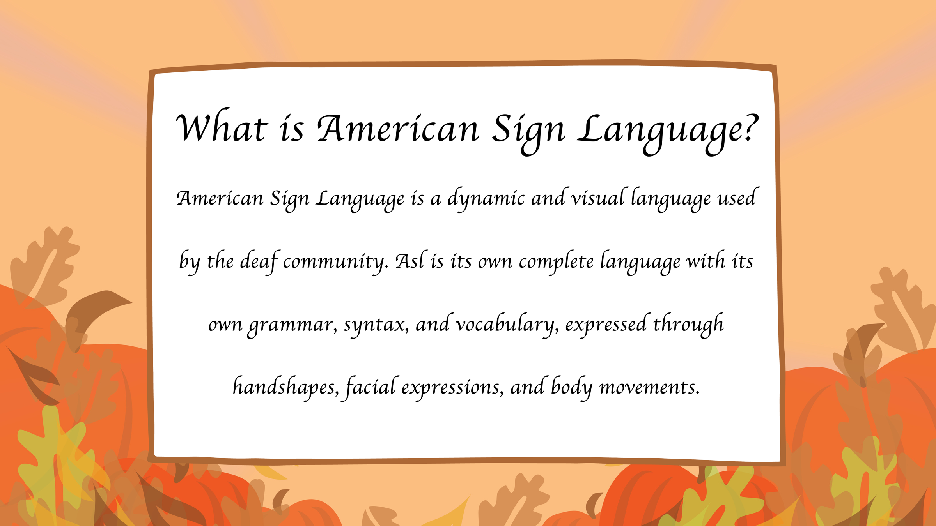

Slide 16
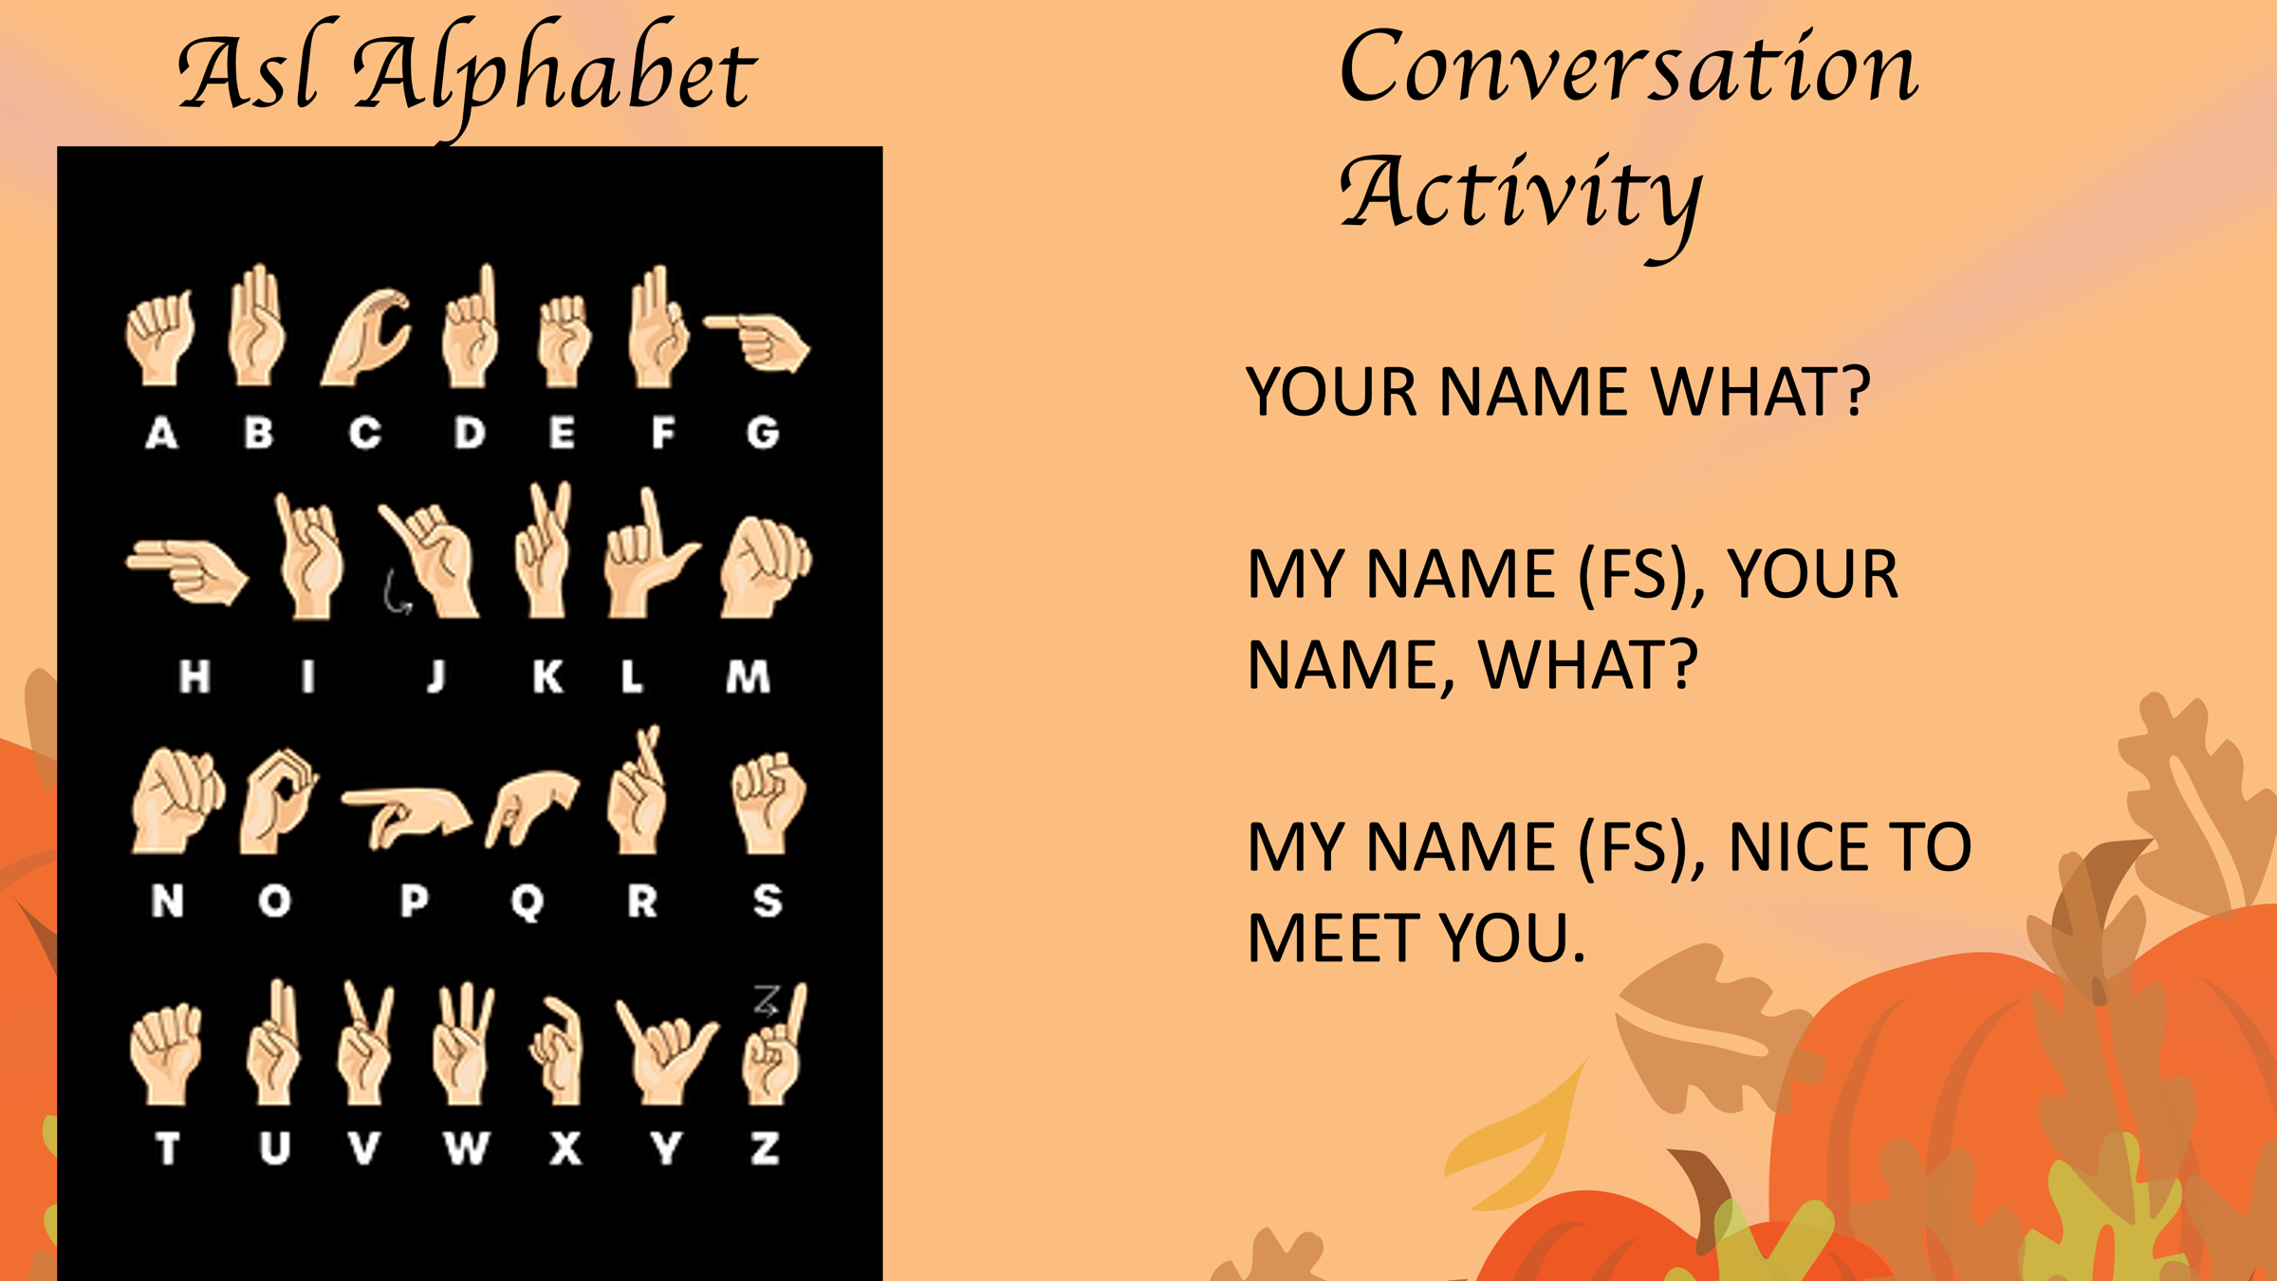

Slide 17
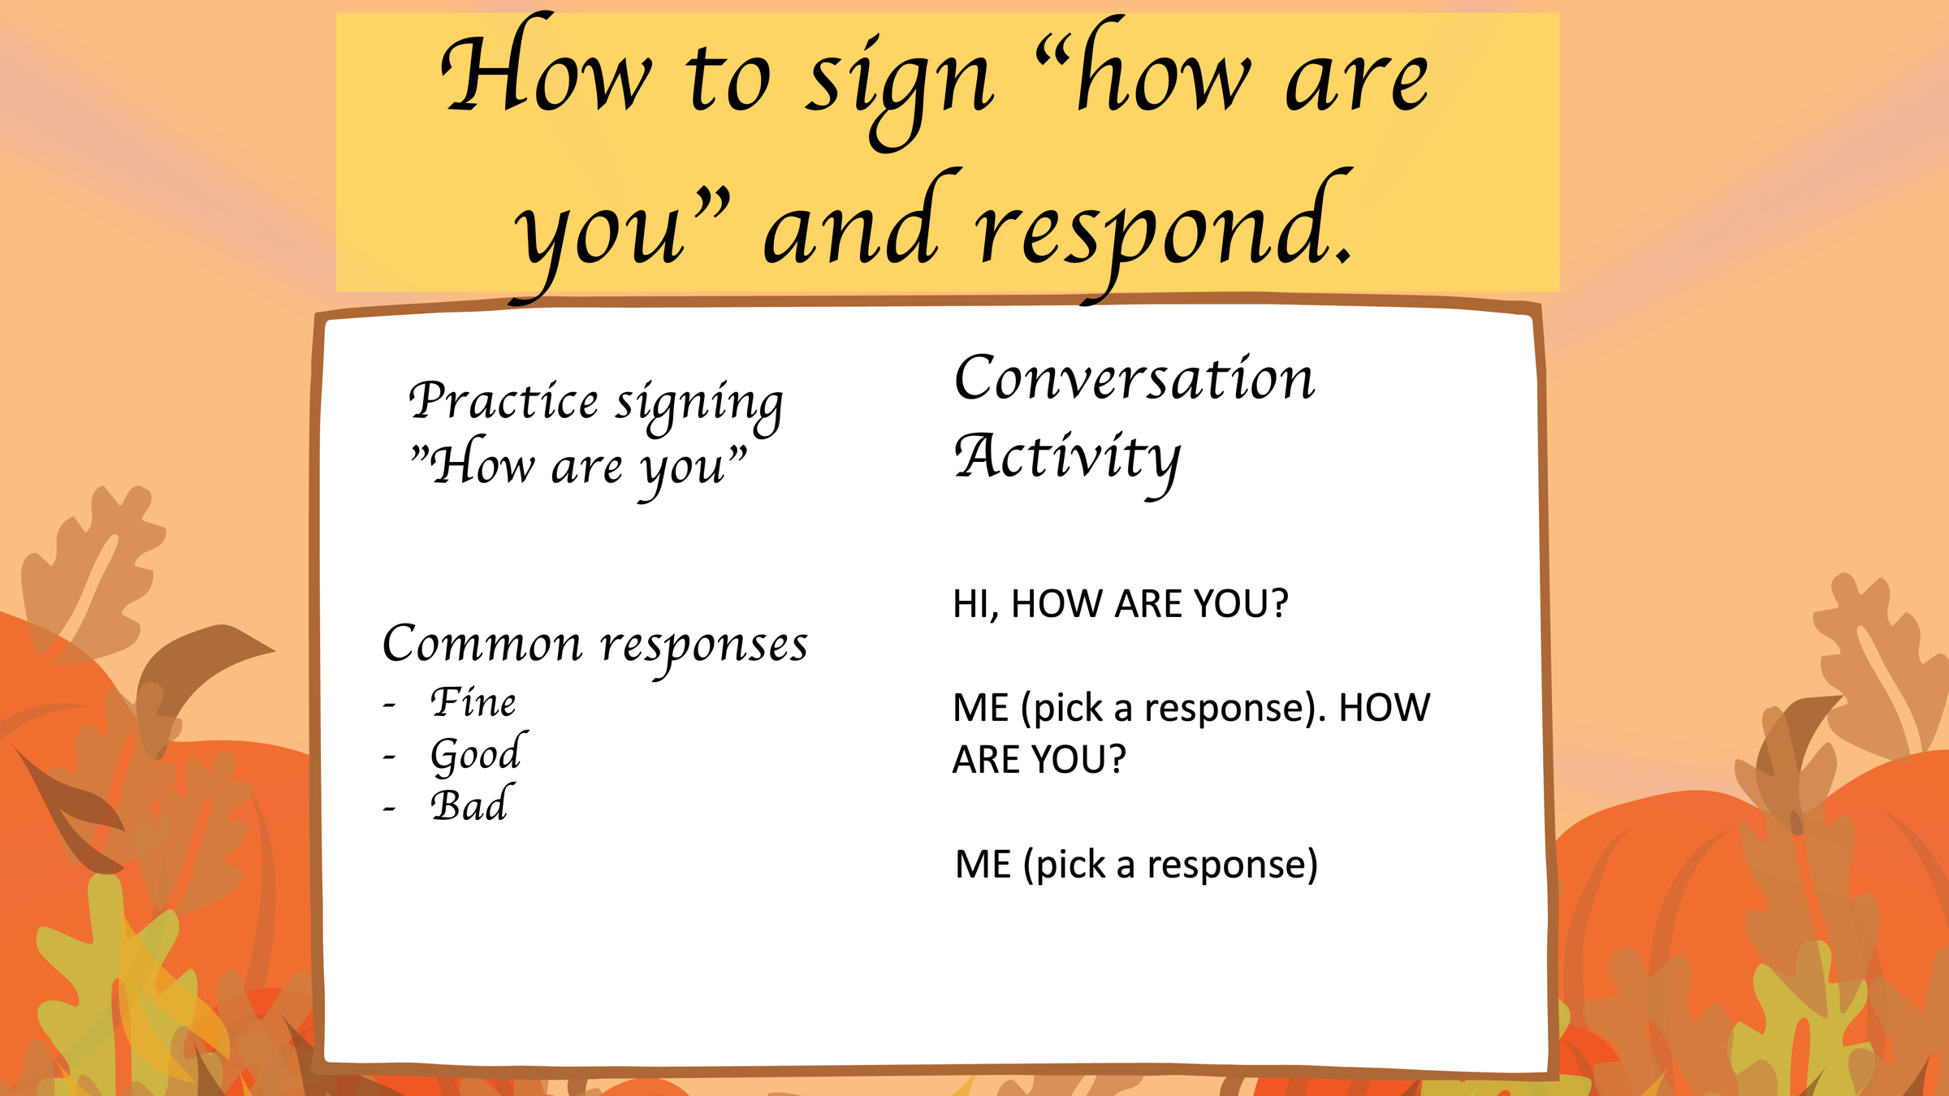

Slide 18
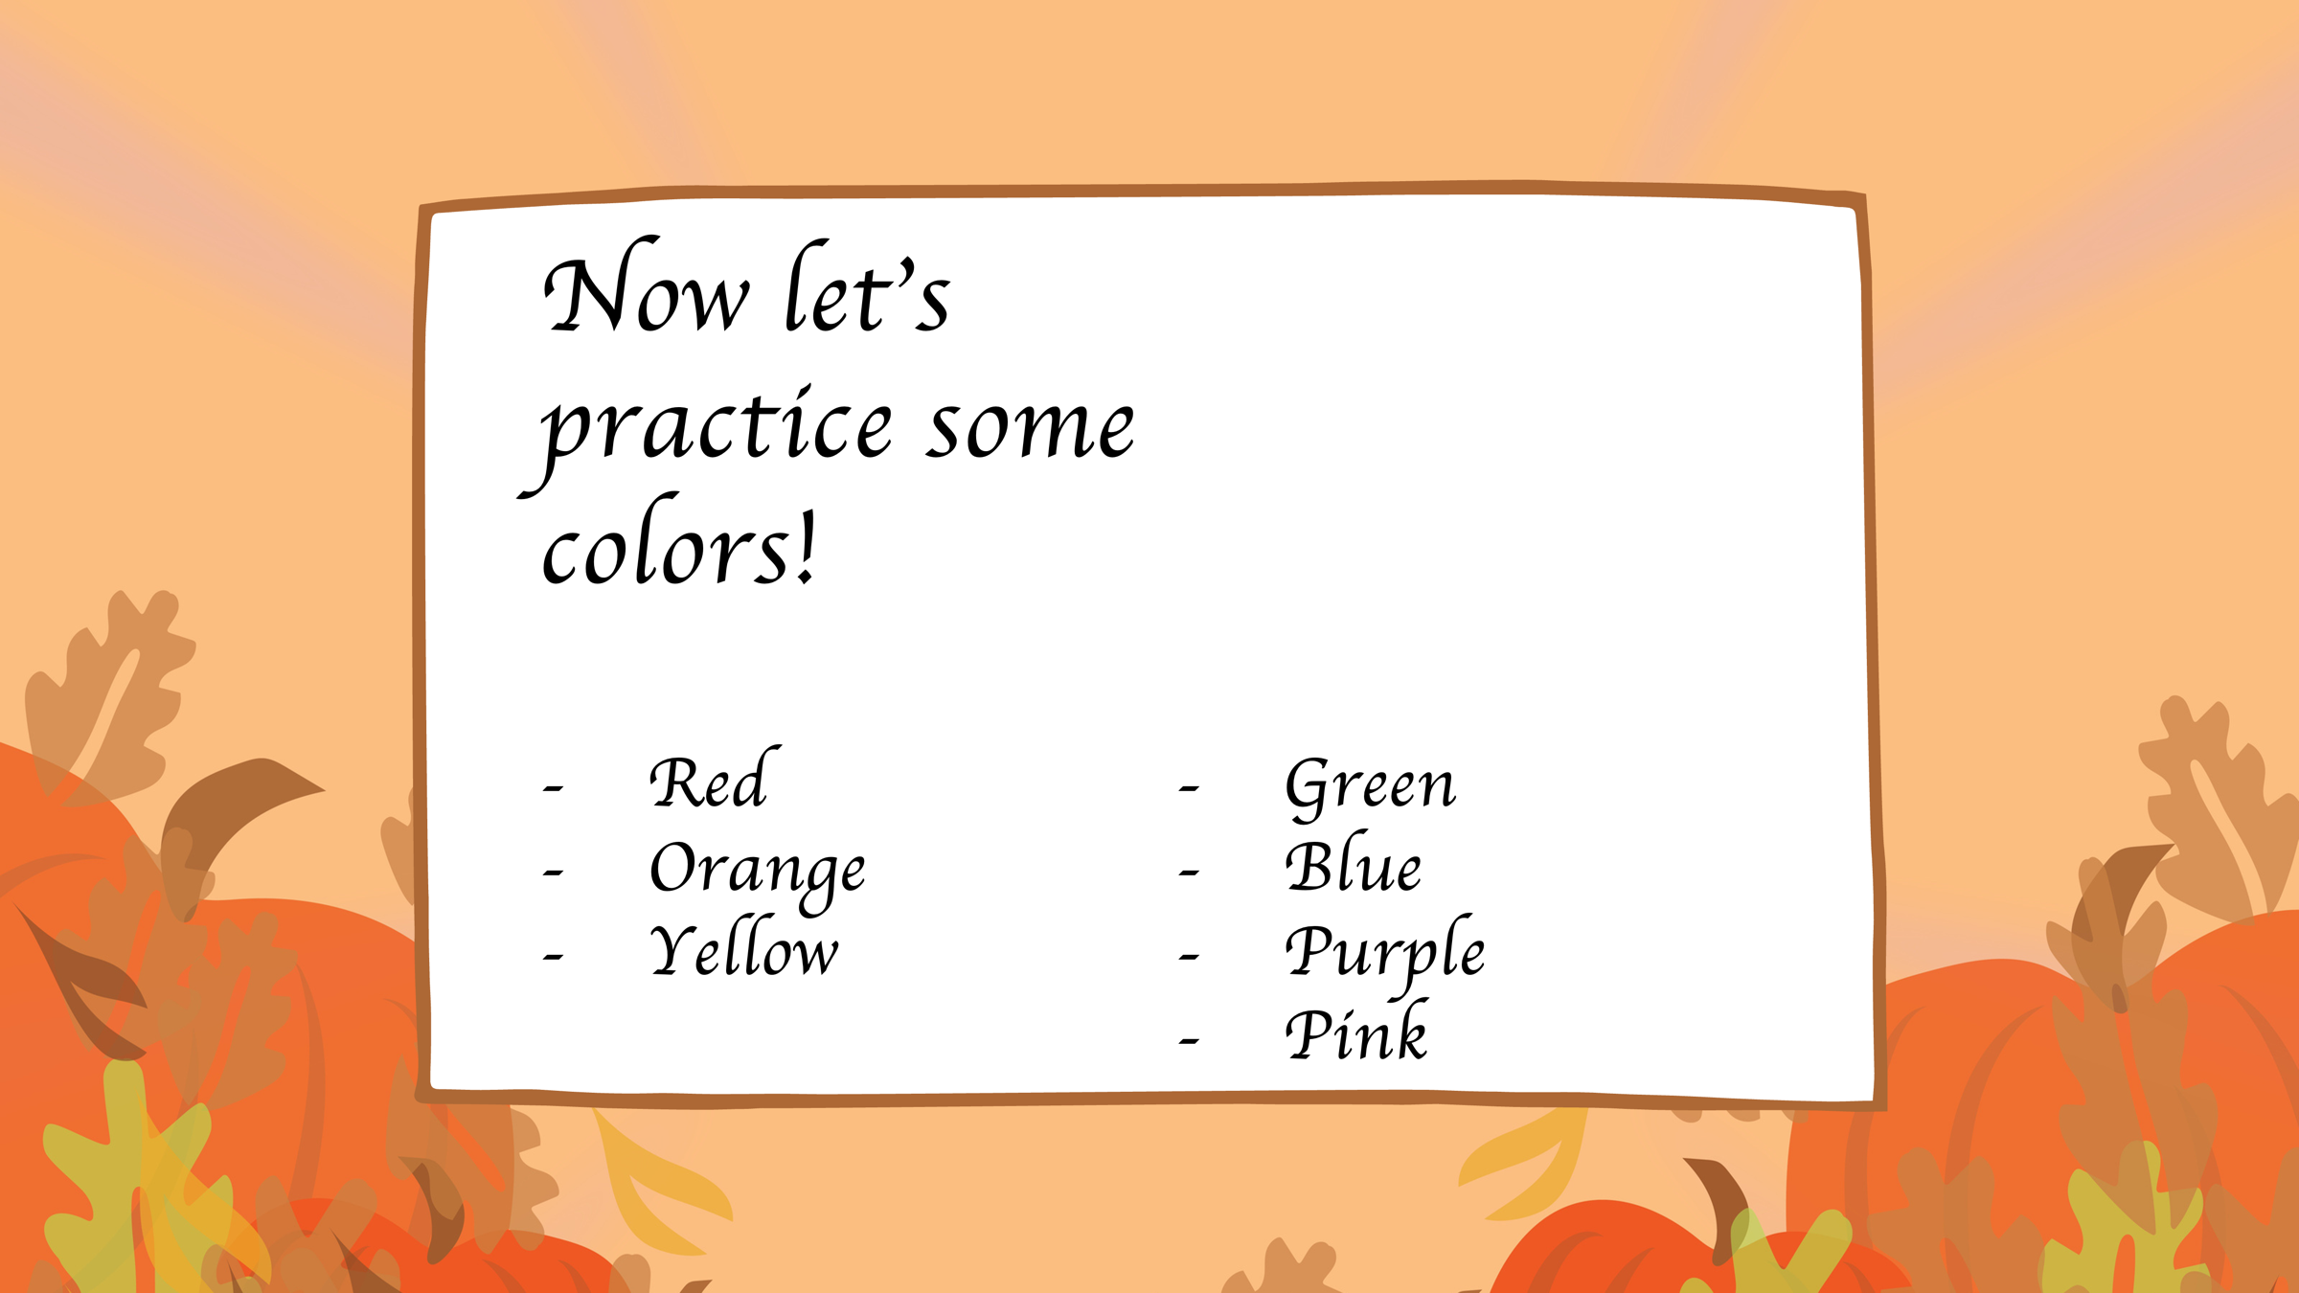

Slide 19
