Slide 1
Graphs and Trees
This handout:
Application examples

Slide 2
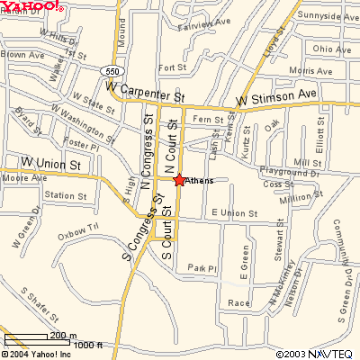
Athens area map

Slide 3
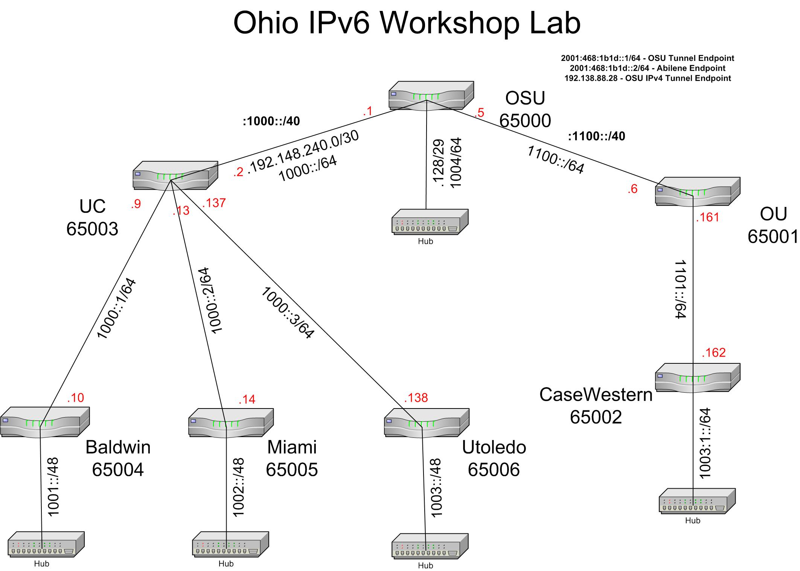

Slide 4
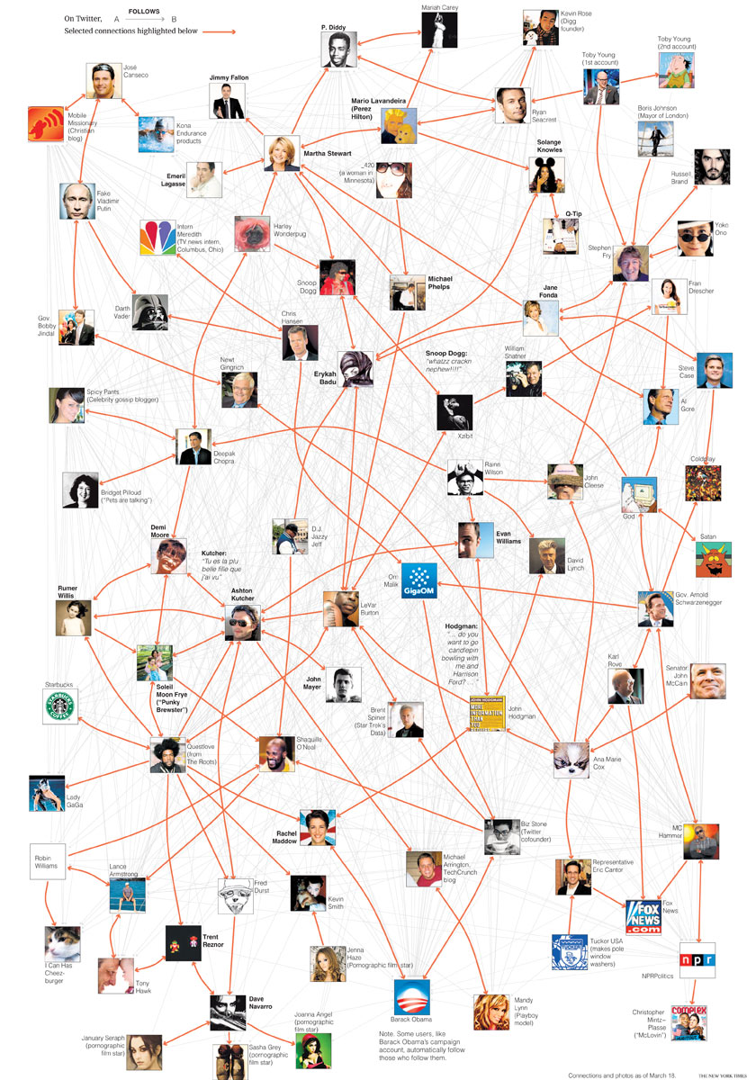
Social network

Slide 5
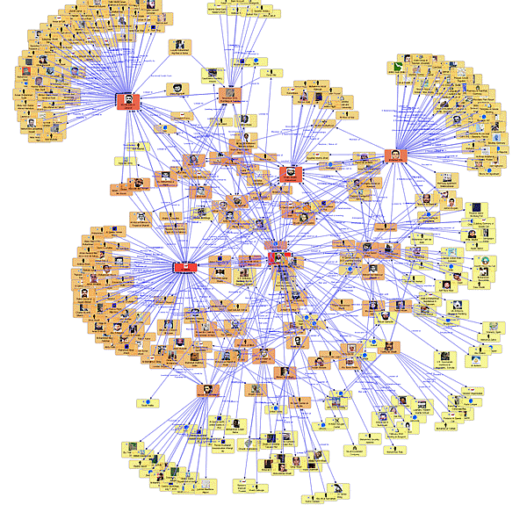
Telephone network

Slide 6
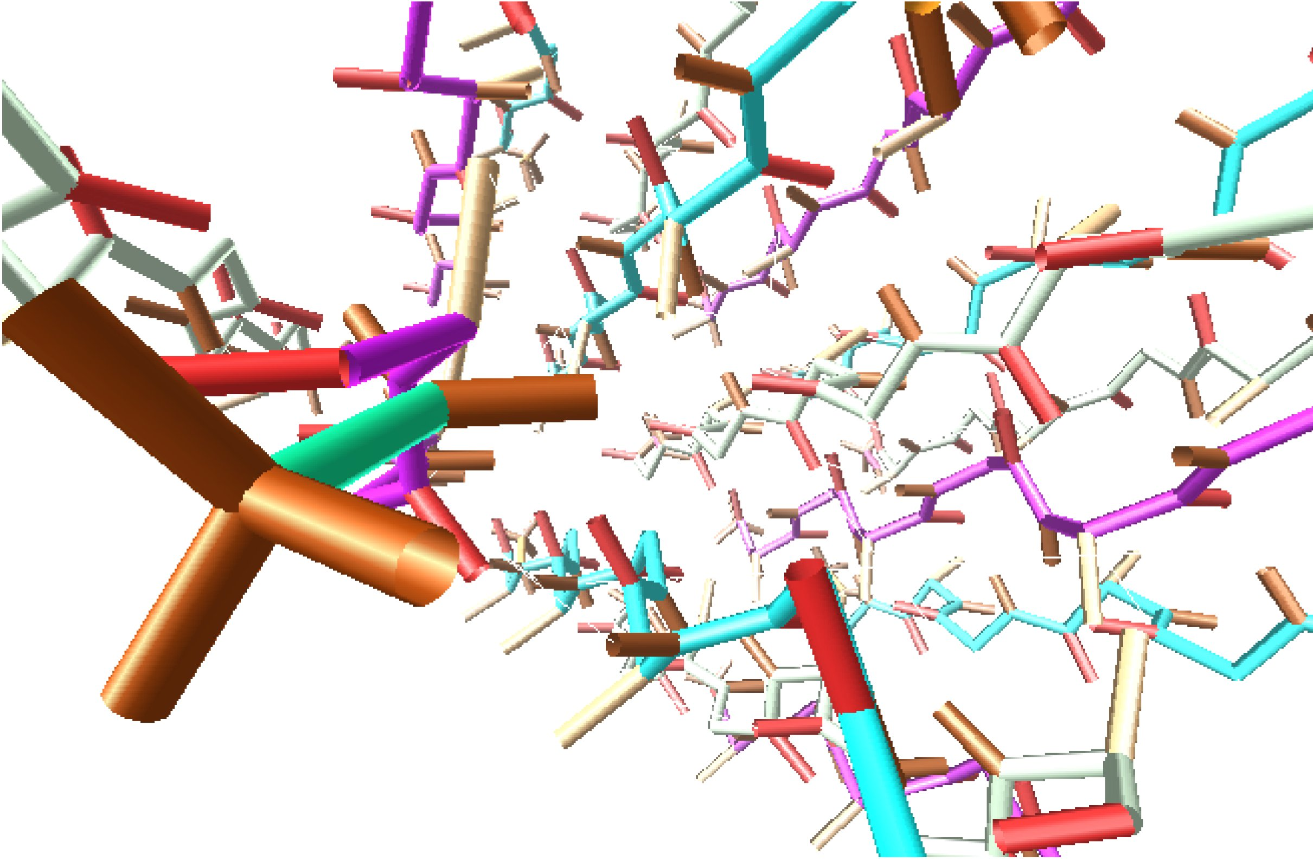
Molecular chain of atoms in protein

Slide 7
Graphs in our daily lives
Transportation
Telephone
Computer
Internet
Social networks
Electrical (power)
Pipelines
Molecular structures in biochemistry

