Slide 1
Chapter 10
Real Inner Products and Least-Square

Slide 2
10.1 Introduction
To any two vectors u and v
of the same dimension having real components,
we associate a scalar called the inner product
denoted as ⟨u, v⟩,
by multiplying together the corresponding elements of u and v and then summing the results.
If u = (u₁, u₂, …, u_{n}) and v = (v₁, v₂, …, v_{n}) are vectors in R^{n}, then the inner product is computed by the following formula:
⟨u, v⟩ = u₁v₁ + u₂v₂ + … + u_{n}v_{n}
Example: If u = (3, 1, 2) and v = (2, -2, 1) then
⟨u, v⟩ = 3(2) + 1(-2) + 2(1) = 6

Slide 3
10.1 Introduction:
Properties of Inner product
  (I1) ⟨u, u⟩ is positive if u ≠ 0;
  ⟨u, u⟩ =0 if and only if u=0.
  (I2) ⟨u, v⟩ = ⟨v, u⟩
  (I3) ⟨u, kv⟩ =k ⟨u, v⟩ for any scalar k
  (I4) ⟨u, v + w⟩ = ⟨u, v⟩ + ⟨u, w⟩
  (I5) ⟨0, v⟩ = ⟨v, 0⟩ = 0

Slide 4
10.1 Introduction
The magnitude of a vector u is denoted by ||u|| and is defined by
||u|| = ⟨u, u⟩^{½}
A nonzero vector is normalized if it is divided by its magnitude.
A unit vector is a vector whose magnitude is unity.
A normalized vector is always a unit vector.
Examples on the board.

Slide 5
Orthogonal Vectors
Definition 1
  Two vectors u and v are called orthogonal (or perpendicular) if ⟨u, v⟩ = 0.
A set of vectors is called an orthogonal set if each vector in the set is orthogonal to every other vector in the set.
Example:
  u₁ = (0, 1, 0), u₂ = (1, 0, 1), u₃ = (1, 0, -1)
  form an orthogonal set since
  ⟨u₁, u₂⟩ = ⟨u₁, u₃⟩ = ⟨u₂, u₃⟩ = 0.

Slide 6
Projections
The following problem occurs often in applied sciences.
Given a nonzero vector x and a nonzero reference vector a,
decompose x into the sum of two vectors, u + v,
where u is parallel to a
and v is perpendicular to a.
u is called the parallel component of x,
v is called the perpendicular component of x.
(parallel and perpendicular with respect to the reference vector a)
a
x
v
u

Slide 7
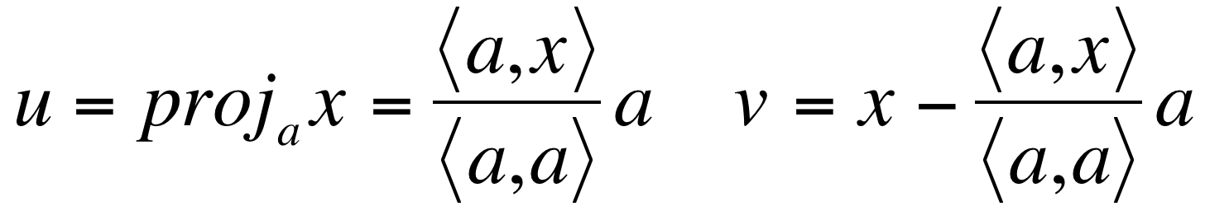
Projections
Since u is parallel to a, u = λa for some scalar λ.
We want x = u + v, then v = x – u = x – λa.
Since u and v are perpendicular, we require that
0 = ⟨u, v⟩ = ⟨λa, x - λa⟩
= λ ⟨a, x⟩ - λ² ⟨a, a⟩
⁼ λ ( ⟨a, x⟩ - λ ⟨a, a⟩ )
Thus, either λ = 0 or λ = ⟨a, x⟩ / ⟨a, a⟩ .
Case 1: λ = 0. Then u = λa = 0 and x = u + v = v
Case 2: λ = ⟨a, x⟩ / ⟨a, a⟩. Then
u is the projection of x onto a,
and v is orthogonal to a.

Slide 8
10.2 Orthonormal Vectors
Definition 2
  A set of vectors is orthonormal if it is an orthogonal set having the property that every vector is a unit vector.
Example:
  Recall that u₁ = (0, 1, 0), u₂ = (1, 0, 1), u₃ = (1, 0, -1) is an orthogonal set; but it is not orthonormal
  The magnitudes of the vectors are
  Normalizing u₁, u₂, and u₃ yields
  The set S = {v₁, v₂, v₃} is orthonormal since
  ⟨v₁, v₂⟩ = ⟨v₁, v₃⟩ = ⟨v₂, v₃⟩ = 0 and ||v₁|| = ||v₂|| = ||v₃|| = 1

Slide 9
10.2 Orthonormal Vectors
Theorem 1: An orthonormal set of vectors is linearly independent.
Proof on the board.
Theorem 2: For every linearly independent set of vectors { x₁, x₂, …, x_{n} },
there exists an orthonormal set of vectors { q₁, q₂, …, q_{n} }
such that
each q_{j} (j=1, 2, …, n) is a linear combination of x₁, x₂, …, x_{n} .

Slide 10
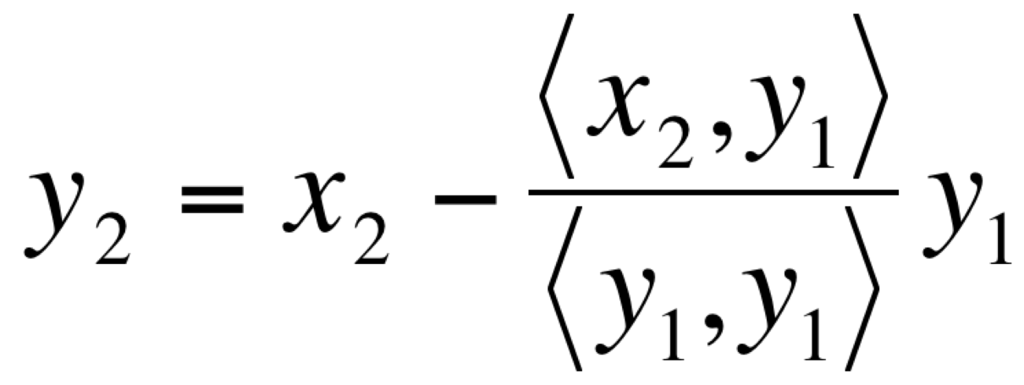
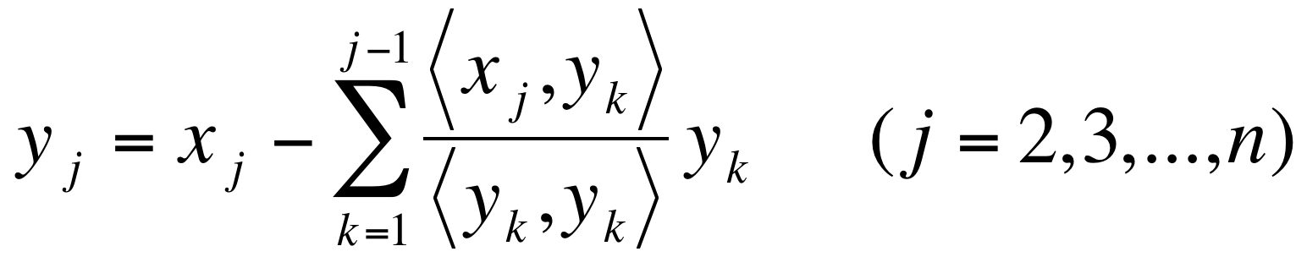
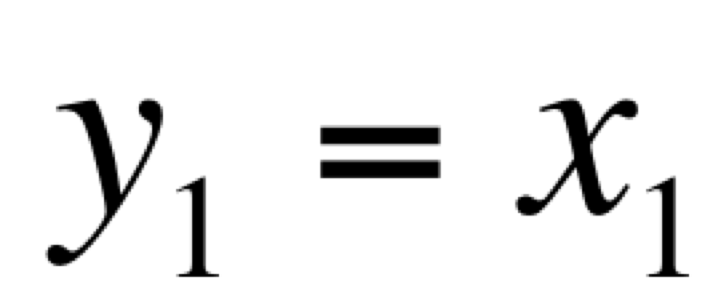
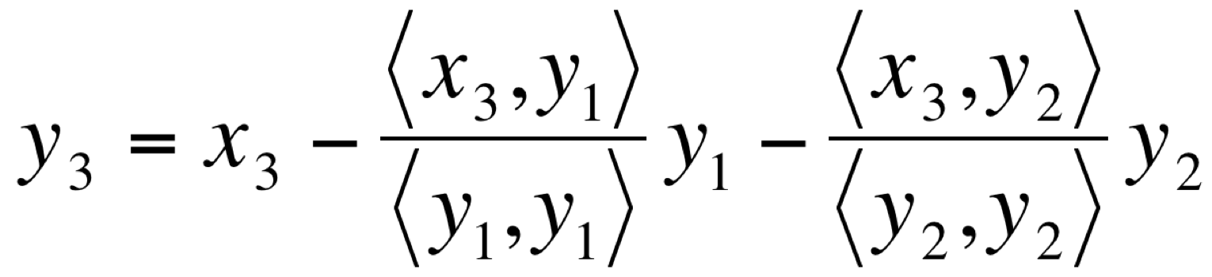
Proof of Theorem 2:
Gram-Schmidt orthonormalization process
First define y₁, y₂, …, y_{n} by
                ( y₂ is orthogonal to y₁ based on our discussion about projections )
and, in general,
y₁, y₂, …, y_{n} form an orthogonal set. By defining q_{j} = y_{j} / ||y_{j}||,
we get an orthonormal set of vectors { q₁, q₂, …, q_{n} }.
This construction is called Gram-Schmidt orthonormalization process. Examples on the board.

Slide 11
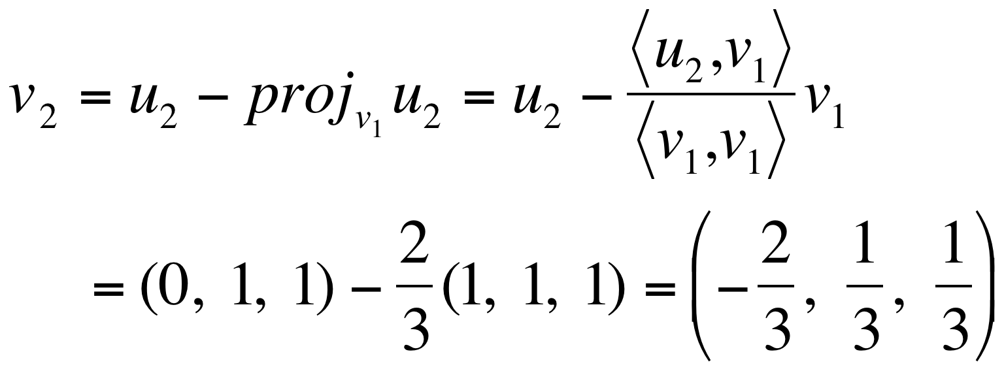
Gram-Schmidt orthonormalization process: example
Apply the Gram-Schmidt process to transform the basis vectors
u₁ = (1, 1, 1), u₂ = (0, 1, 1), u₃ = (0, 0, 1)
into an orthogonal basis {v₁, v₂, v₃}; then normalize the orthogonal basis vectors to obtain an orthonormal basis {q₁, q₂, q₃}.
Solution:
  Step 1: v₁ = u₁ = (1, 1, 1)
  Step 2:

Slide 12
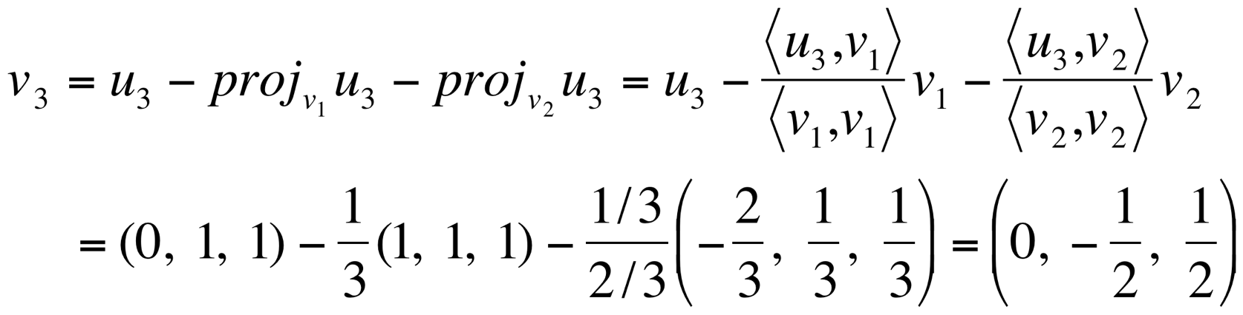
Gram-Schmidt orthonormalization process: example
  Step 3:
  Thus, v₁ = (1, 1, 1), v₂ = (-2/3, 1/3, 1/3), v₃ = (0, -1/2, 1/2) form an orthogonal basis. The magnitudes of these vectors are
  so an orthonormal basis is

