Slide 1
Chapter 10 Real Inner Products and Least-Square (cont.)
In this handout:
Angle between two vectors
Revised Gram-Schmidt algorithm
QR-decompoistion of matrices
QR-algorithm for finding eigenvalues (optional)

Slide 2
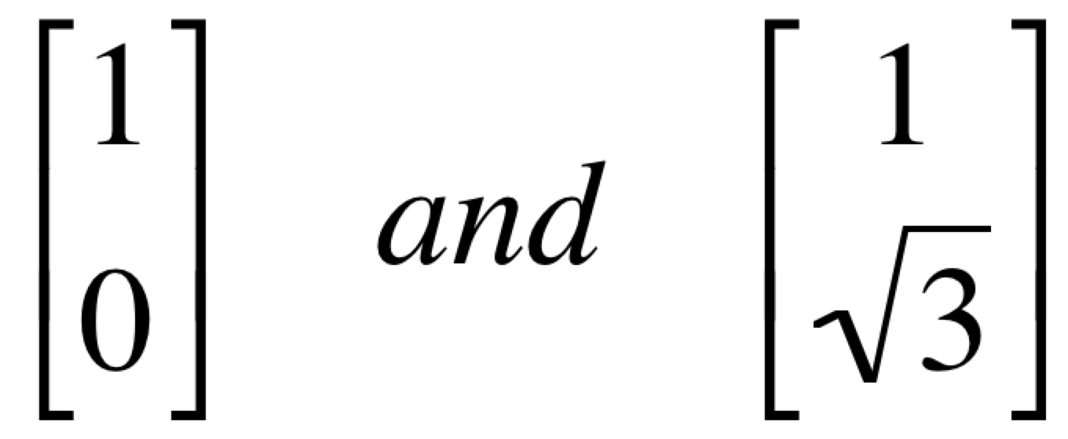
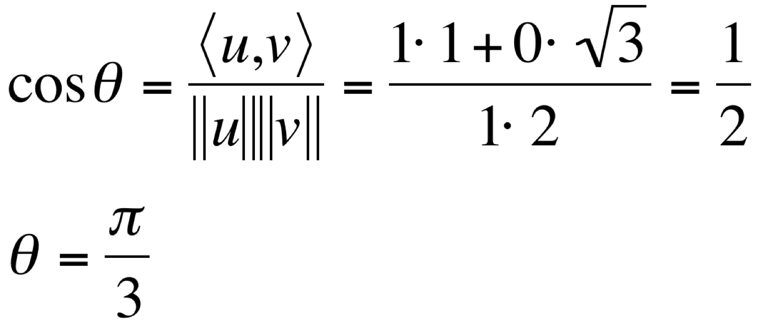
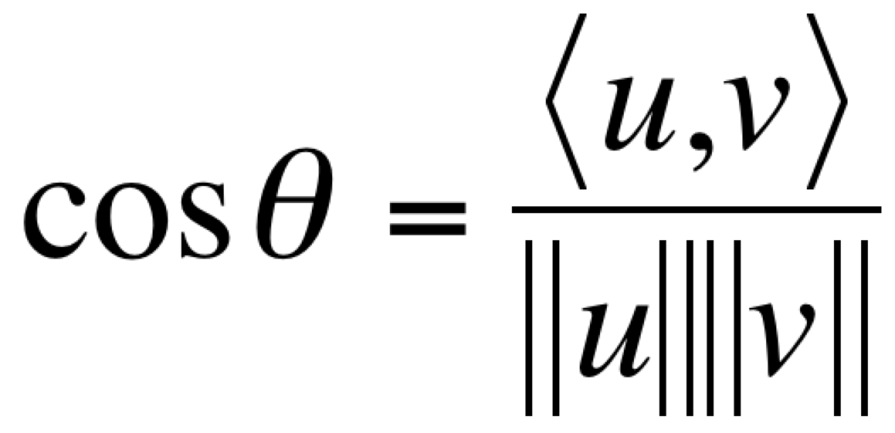
Angle between two vectors
Inner products can be used to compute the angle between two vectors u and v:
Example: Find the angle between vectors

Slide 3
Revised Gram-Schmidt algorithm
A revised version of Gram-Schmidt normalizes the orthogonal vectors as soon as they are obtained.
Given a set of linearly independent set of vectors { x₁, x₂, …, x_{n} },
For k = 1 .. n
Calculate r_{kk} = ⟨x_{k} , x_{k}⟩^{½}
Set q_{k} = (1/r_{kk})x_{k}
For j = k+1 .. n
- calculate r_{kj} = ⟨x_{j} , q_{k}⟩
- replace x_{j} by x_{j} – r_{kj} q_{k}
The first two steps normalize, the third step subtract projections from vectors, thereby generating orthogonality.

Slide 4
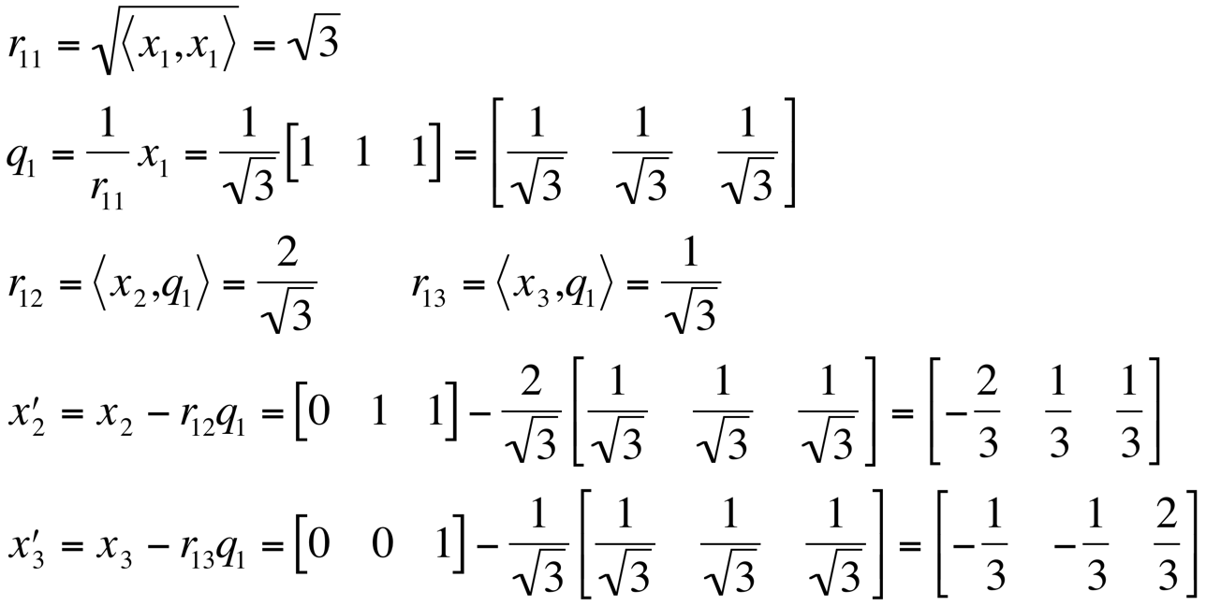
Revised Gram-Schmidt algorithm: example
Example: Apply revised Gramm-Schmidt to construct orthonormalize the following set of vectors:
x₁ = (1, 1, 1), x₂ = (0, 1, 1), x₃ = (0, 0, 1)
Iteration 1 (k=1):

Slide 5
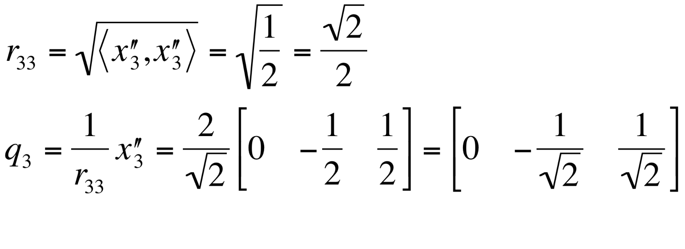
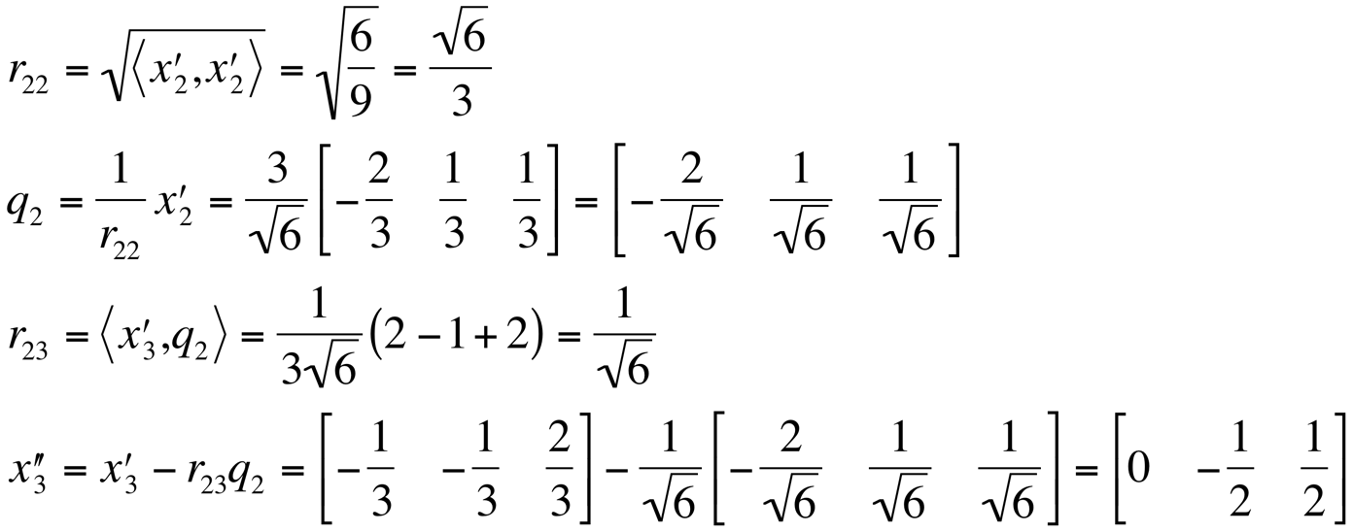
Revised Gram-Schmidt algorithm: example (cont.)
Iteration 2 (k=2):
Iteration 3 (k=3):

Slide 6
QR-decomposition
The revised algorithm has several advantages. Particularly, the inverse process - recapturing the x-vectors from the q-vectors is more trivial.
If we set X = [ x₁ x₂ … x_{n} ], Q = [ q₁ q₂ … q_{n} ]
and
$$R=\left[\begin{matrix}r_{11} & ⋯ & r_{1n} \\ ⋮ & ⋱ & ⋮ \\ 0 & ⋯ & r_{nn}\end{matrix}\right]$$
we have the matrix representation X = QR which is known as the QR-decomposition of the matrix X.
The columns of Q form an orthonormal set of column vectors, and R is upper triangular.

Slide 7
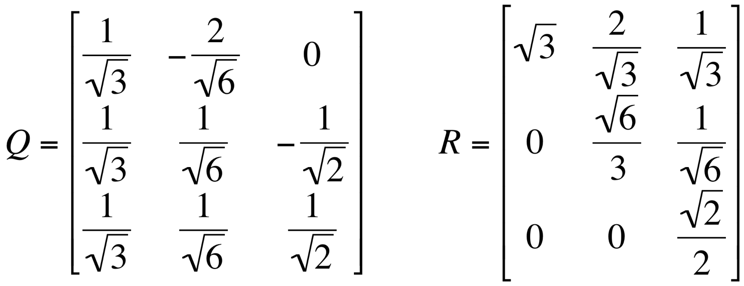
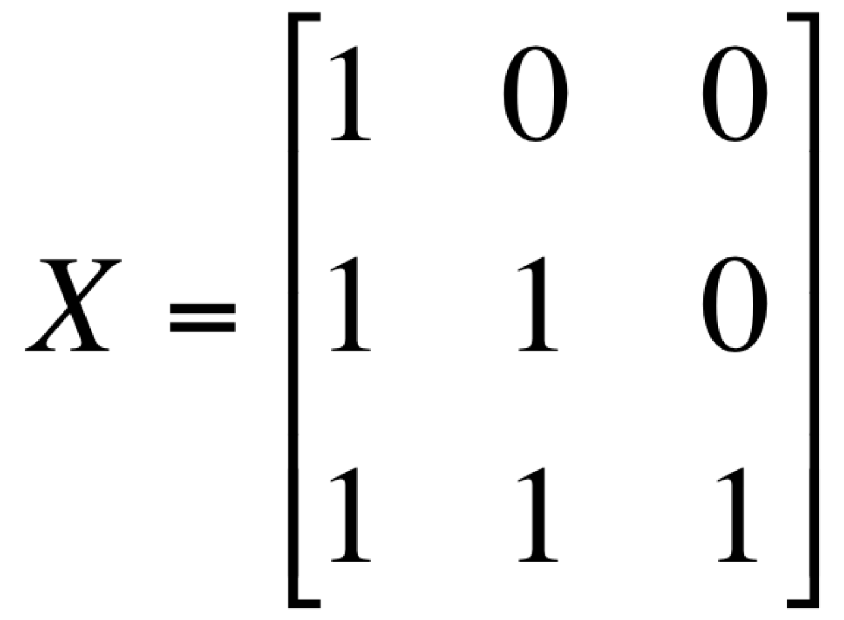
Example of QR-decomposition
Example: Consider matrix
Recall that we applied revised Gram-Schmidt to the column-vectors of this matrix x₁ = (1, 1, 1), x₂ = (0, 1, 1), x₃ = (0, 0, 1) to obtain an orthonormalized set of vectors
Thus,

Slide 8
The QR-Algorithm (optional)
One of the main applications of QR-decomposition is the QR-algorithm for computing the eigenvalues of real matrices.
Unlike power methods (Section 6.6), the QR-algorithm generally finds all eigenvalues.
The QR-algorithm was recognized as one of the top ten algorithms with the greatest influence on the development and practice of science and engineering in the 20th century (Journal of Computing in Science and Engineering):
http://www.computer.org/csdl/mags/cs/2000/01/c1022.html

Slide 9
The QR-Algorithm (optional)
The QR-algorithm is iterative.
Given a square matrix A₀ we want to find its eigenvalues.
A sequence of new matrices A₁ , A₂ , …, A_{k} is created such that each new matrix has the same eigenvalues as A₀ . These eigenvalues become increasingly obvious as the sequence progresses. To calculate A_{k} once A_{k-1} is known, first construct a QR-decomposition of A_{k-1}:
A_{k-1} = Q_{k-1}R_{k-1}
Then reverse the order of the product to define
A_{k} = R_{k-1}Q_{k-1}
It can be shown that eigenvalues of A_{k-1} and A_{k} are the same.
The sequence of matrices generally converges to a form for which eigenvalues can be easily determined.
See Section 10.4 for more details.

