Slide 1
Dynamic Programming
In this handout
Stochastic Dynamic Programming

Slide 2
Probabilistic Dynamic Programming
So far we have assumed that a specification of the current state and current decision is enough to determine with certainty the state we will end up in the next stage.
However, in many practical situations there might be some external factors, like stochastic demand for a product, that might affect the resulting state in the next stage.
Thus, it is more realistic to assume that there is a probability distribution for what the next state will be. In this case the model is known as probabilistic dynamic programming.

Slide 3
Probabilistic Dynamic Programming
Suppose we are in state s_{n} of stage n and making a decision x_{n}.
Then the system might go to several different states of stage n+1 based on a probability distribution which is completely determined by the current state and current decision. Namely, the system goes to state i with probability p_{i} (i=1,2,…,S).
We still want to find the optimal policy decision at each stage for each of the possible states. But this time the objective function is an expected value of a random variable.
Because of the probabilistic structure, the recursive relationship in this case is somewhat more complicated.

Slide 4
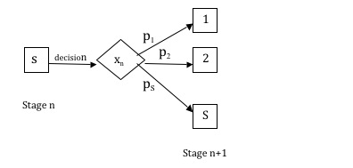
The basic structure for Probabilistic Dynamic Programming

Slide 5
Inventory problem with random demands
3 production periods
No inventory at the beginning
Can produce at most 3 units in each period
Can keep at most 2 units in inventory
Set-up cost for each period is 5
The demand is not known in advance. It is given by a probability distribution (see next slide).
Period | 1 | 2 | 3
Unit cost | 3 | 5 | 4

Slide 6
Inventory problem with random demands
The demand for each period is given by a probability distribution:
The penalty cost for each unit of unsatisfied demand is 9
The units exceeding inventory limit are discarded
Determine a production schedule to minimize the total expected cost (the DP solution on the board).
Period | Demand distribution
 | 0 | 1 | 2
1 | .2 | .5 | .3
2 | .1 | .4 | .5
3 | .2 | .4 | .4

