Slide 1
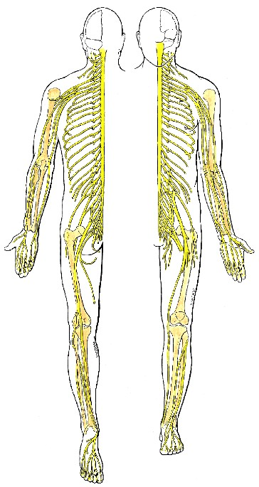
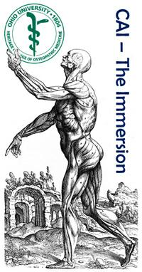
Peripheral Nervous System 1:
The Somatic System
24 July 2017
Reading: Moore’s ECA5 27–33
ECA4 31–36
Lawrence M. Witmer, PhD
Professor of Anatomy
Dept. of Biomedical Sciences
Heritage College of Osteopathic Medicine, Ohio University
Athens, Ohio 45701
witmerL@ohio.edu
Grant’s Atlas 12 2009

Slide 2
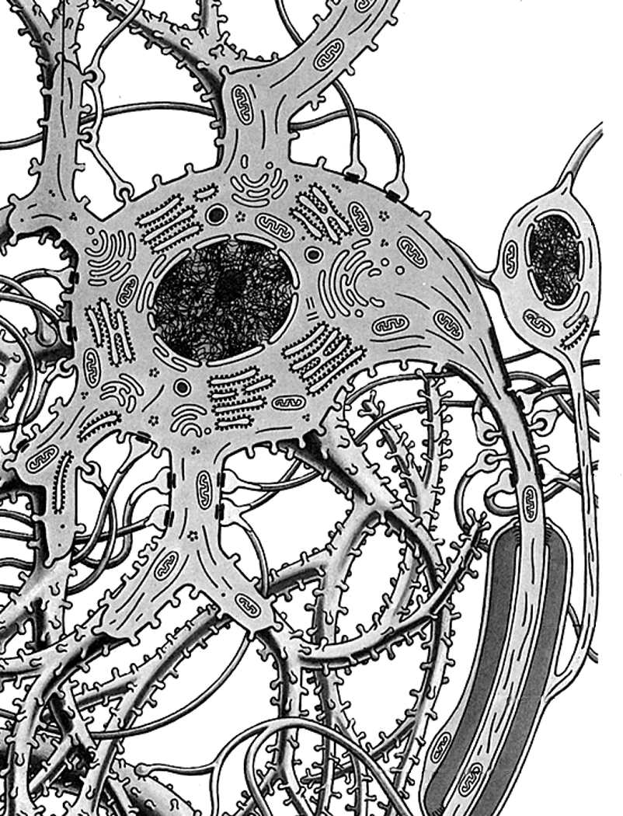
Dichotomies
neuron
1. Tissues: neurons vs. glia
2. Position: CNS vs. PNS
3. Function 1: sensory vs. motor
4. Function 2: somatic vs. visceral
glial cell
Gray’s Anatomy 38 1999

Slide 3
Neurons
• Dendrites: carry nerve impulses toward cell body
• Axon: carries impulses away from cell body
• Synapses: site of communication between neurons using chemical neurotransmitters
• Myelin & myelin sheath: lipoprotein covering produced by glial cells (e.g., Schwann cells in PNS) that increases axonal conduction velocity
• Demyelinating diseases: e.g., Multiple Sclerosis (MS) in CNS or Guillain- Barré Syndrome in PNS
dendrites
cell
body
axon with
myelin sheath
Schwann
cell
synapses
Moore’s COA6 2010

Slide 4
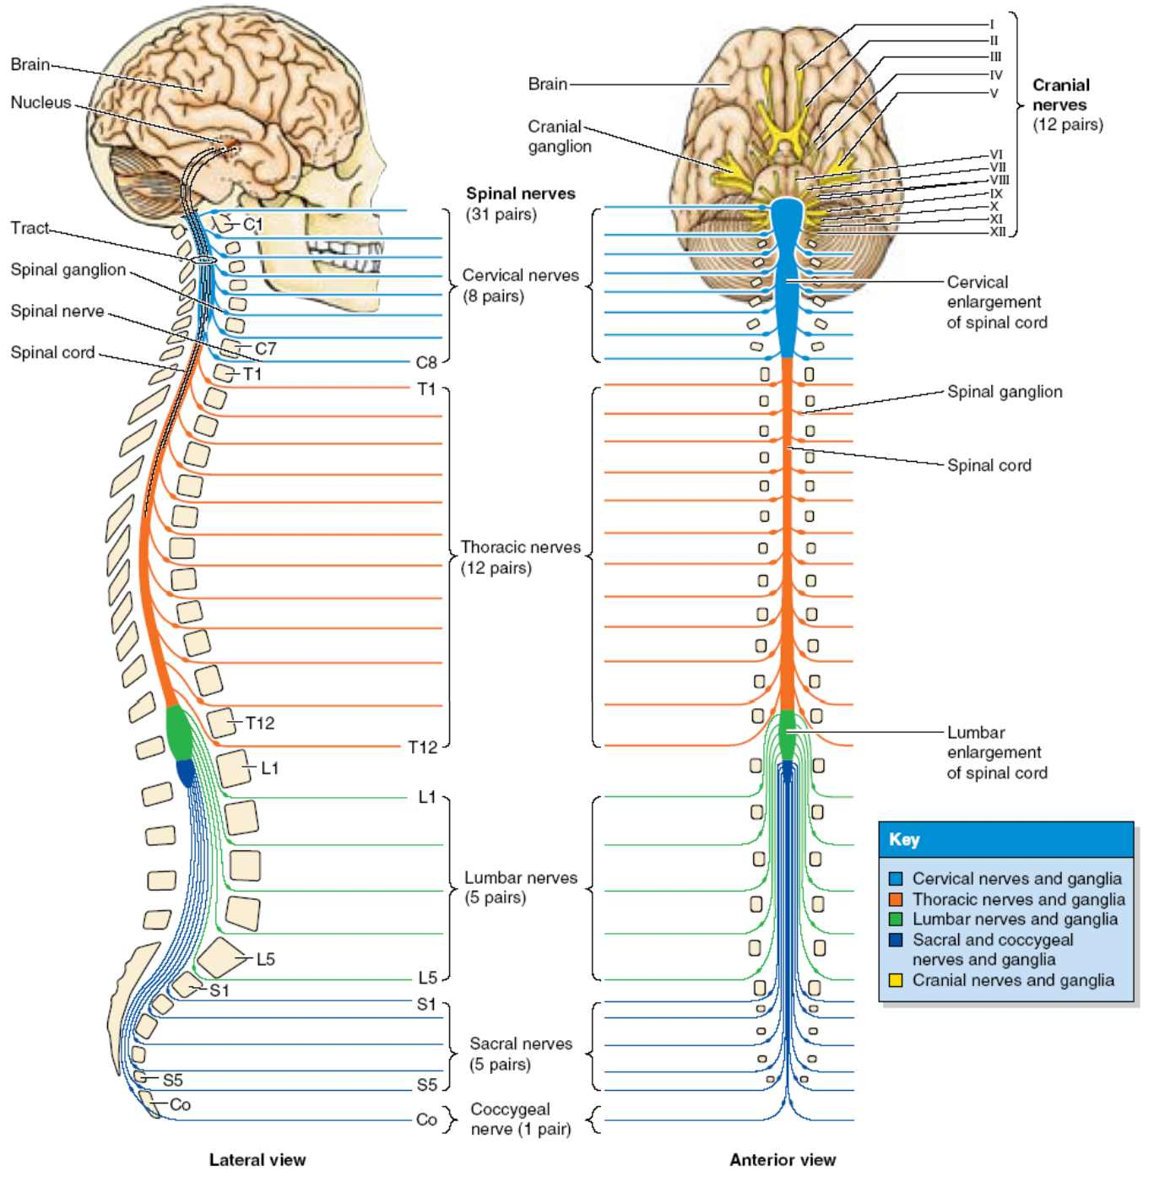
CNS vs. PNS
Central Nervous System
• brain & spinal cord
• integration of info passing to & from the periphery
Peripheral Nervous System
• 12 cranial nerves
• 31 pairs of spinal nerves
• Naming convention changes at C7/T1
Collection of nerve
cell bodies:
• CNS: nucleus
• PNS: ganglion
Moore’s COA6 2010

Slide 5
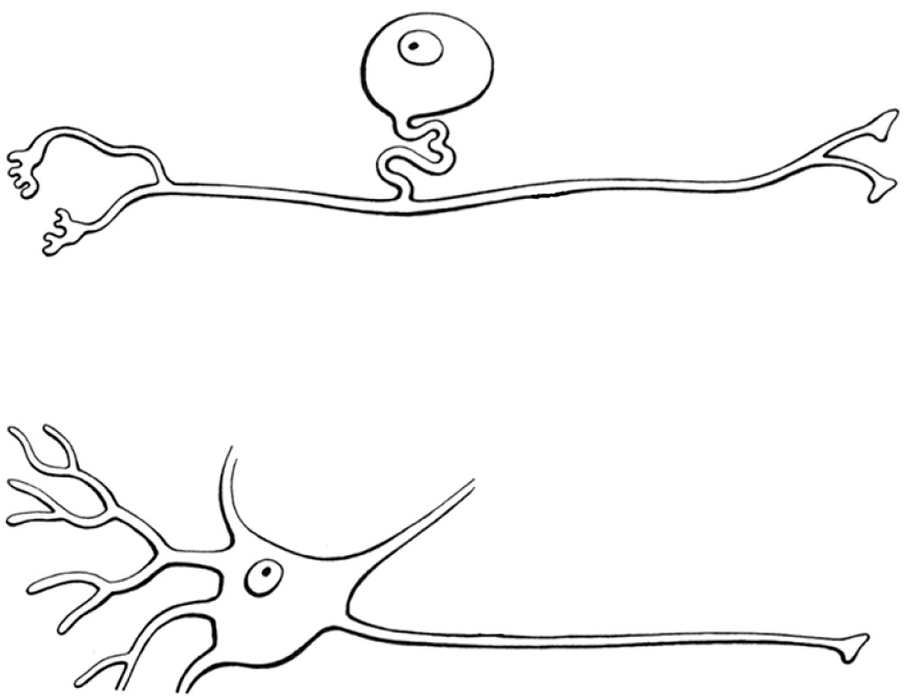
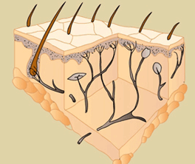
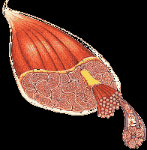
Sensory (Afferent) vs. Motor (Efferent)
sensory (afferent) nerve
CNS
(pseudo-) unipolar neurons conducting impulses
from sensory organs to the CNS
e.g., skin
motor (efferent) nerve
CNS
multipolar neurons conducting impulses
from the CNS to effector organs (muscles & glands)
e.g., muscle
Gray’s Anatomy 38 1999

Slide 6
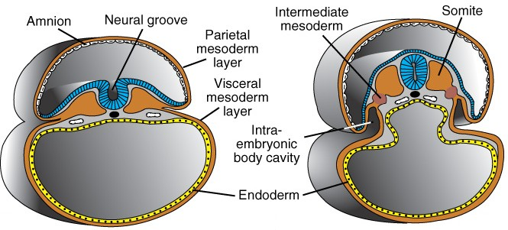
Somatic vs. Visceral
attribute | Somatic System | Visceral System
embryological origin of tissue | “body wall:” somatic (parietal) mesoderm (dermatome, myotome) | “organs:” splanchnic (visceral) mesoderm, endoderm
examples of adult tissues | dermis of skin, skeletal muscles, connective tissues | glands, cardiac muscle, smooth muscle
perception | conscious, voluntary | unconscious, involuntary
Langman’s Embryo 9 2004

Slide 7
Sensory/Motor + Somatic/Visceral
 | Somatic | Visceral
Sensory (Afferent) | somatic sensory [General Somatic Afferent (GSA)] | visceral sensory [General Visceral Afferent (GVA)]
Motor (Efferent) | somatic motor [General Somatic Efferent (GSE)] | visceral motor [General Visceral Efferent (GVE)]
Somatic
Nervous
System
Autonomic
Nervous
System
(today)
(August 7)

Slide 8
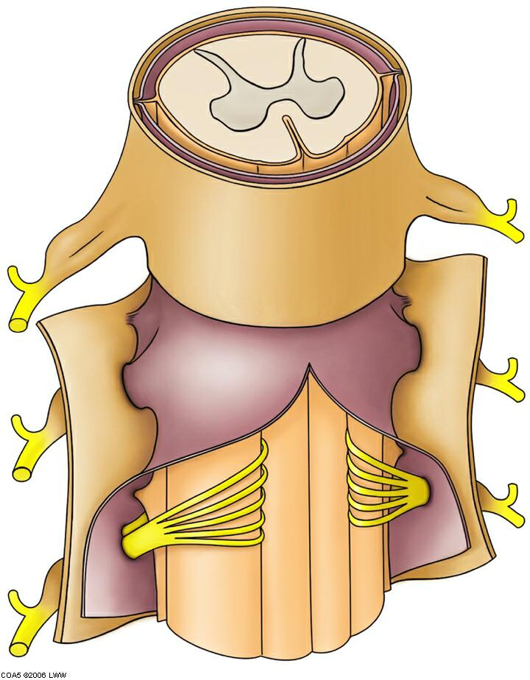
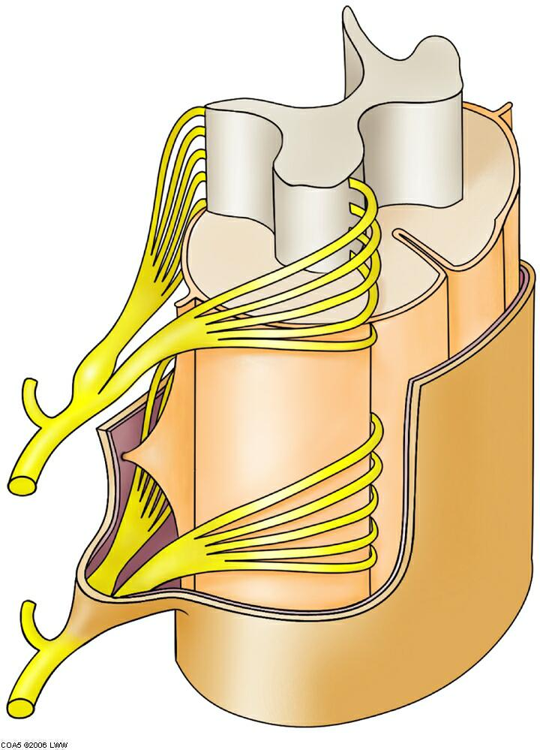
Structure of the Spinal Cord
white matter
(axons)
gray matter (cell bodies)
• dorsal (posterior) horn
• ventral (anterior) horn
ventral
rootlets
dorsal
rootlets
meninges
pia •
arachnoid •
dura •
denticulate
ligament
dorsal root
(spinal) ganglion
subarachnoid
space
(CSF)
• dura
• arachnoid
• pia
meninges
spinal nerve
• dorsal primary ramus
• ventral primary ramus
Moore’s COA6 2010
ventral root

Slide 9
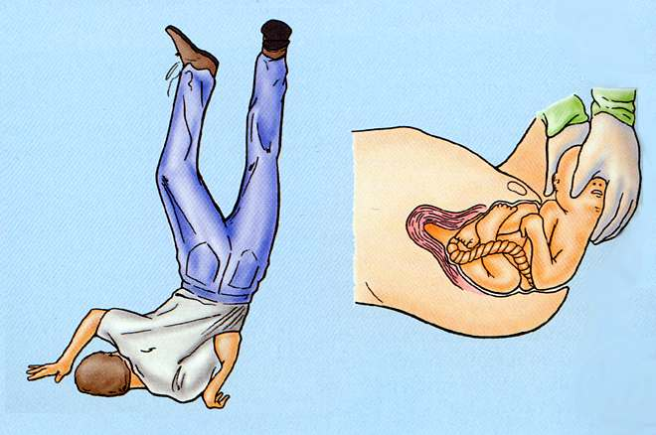
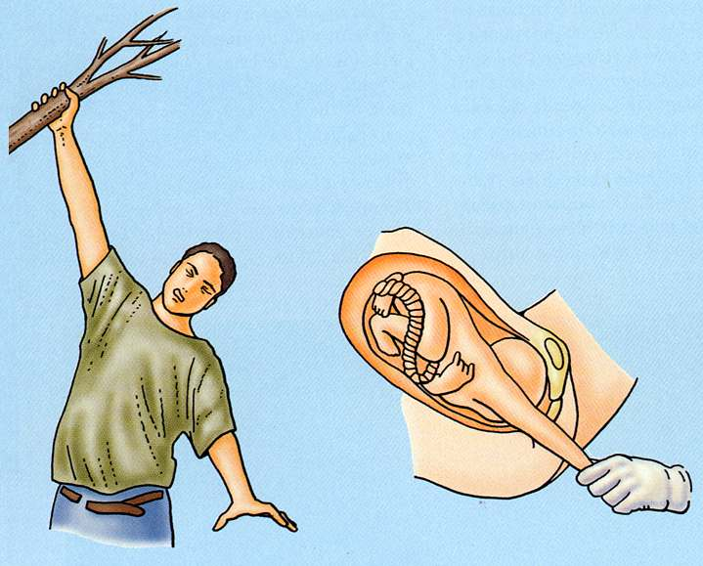
Rootlet Damage
Upper brachial
plexus injuries
Upper Brachial Plexus Injuries
• Increase in angle between neck & shoulder
• Traction (stretching or avulsion) of upper rootlets (e.g., C5,C6)
• Produces Erb’s Palsy
Lower Brachial Plexus Injuries
• Excessive upward pull of limb
• Traction (stretching or avulsion) of lower rootlets (e.g., C8, T1)
• Produces Klumpke’s Palsy
Lower brachial
plexus injuries
http://www.oucom.ohiou.edu/dbms-witmer/
Downloads/2003-09-17_Ortho_Anat.pdf
“Obstetrical” or “Birth palsy”
• Becoming increasingly rare
• Categorized on basis of damage
• Type I: Upper (C5,6), Erb’s
• Type II: All (C5-T1), both palsies
• Type III: Lower (C8, T1),
Klumpke’s Palsy
Moore’s COA6 2010

Slide 10
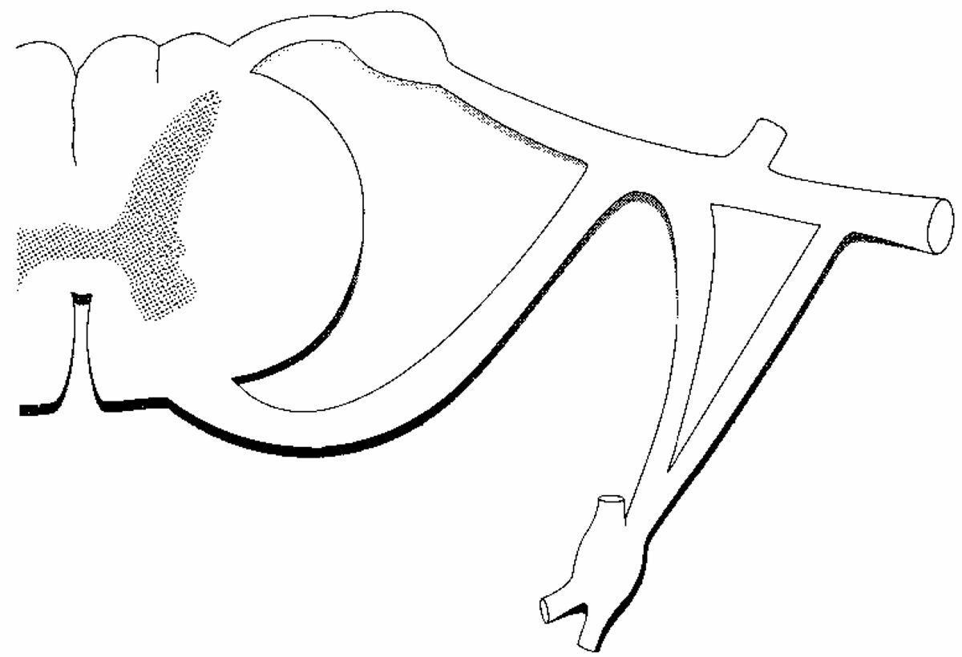
Structure of Spinal Nerves: Somatic Pathways
dorsal root
ganglion
dorsal
ramus
dorsal root
dorsal
horn
spinal
nerve
somatic
sensory
nerve
(GSA)
CNS
inter-
neuron
ventral
horn
somatic
motor
nerve
(GSE)
ventral
ramus
ventral root
white ramus
communicans
Mixed Spinal
Nerve
sympathetic
ganglion
gray ramus
communicans

Slide 11
Structure of Spinal Nerves: Somatic Pathways
dorsal root
ganglion
dorsal
ramus
dorsal root
dorsal
horn
spinal
nerve
somatic
sensory
nerve
(GSA)
CNS
inter-
neuron
ventral
horn
somatic
motor
nerve
(GSE)
ventral
ramus
Somatic sensations
• touch, pain, temperature,
pressure
• proprioception: joints, muscles
Somatic motor activity: innervate skeletal muscles
ventral root
white ramus
communicans
Mixed Spinal
Nerve
sympathetic
ganglion
gray ramus
communicans

Slide 12
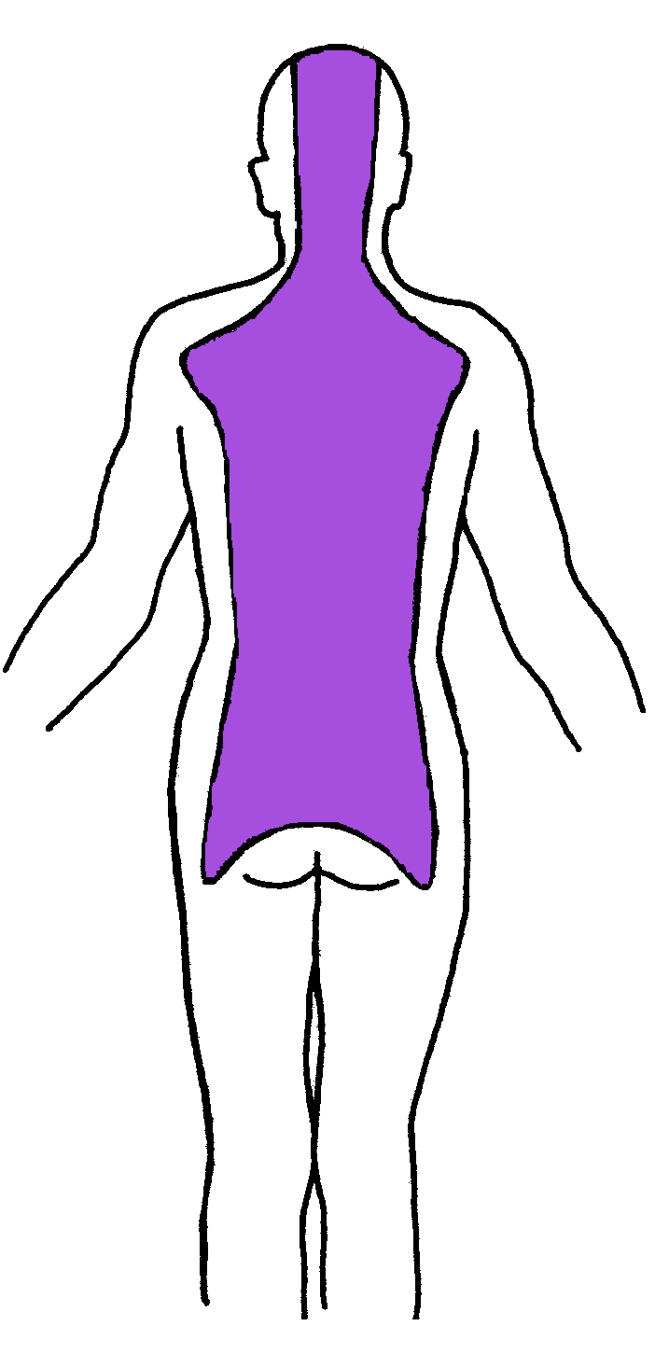
Structure of Spinal Nerves: Dorsal & Ventral Rami
dorsal
ramus
spinal
nerve
somatic
sensory
nerve
(GSA)
somatic
motor
nerve
(GSE)
Territory of Dorsal Rami
(everything else, but head,
innervated by ventral rami)
ventral
ramus
Stern Essentials of Gross Anatomy

Slide 13
Impact of Lesions
Disruption of sensory (afferent) neurons (paresthesia)
somatic
sensory
nerve
(GSA)
somatic
motor
nerve
(GSE)

Slide 14
Impact of Lesions
somatic
sensory
nerve
(GSA)
somatic
motor
nerve
(GSE)
Disruption of motor
(efferent) neurons
(paralysis)

Slide 15
Impact of Lesions
Disruption of sensory (afferent) neurons (paresthesia)
somatic
sensory
nerve
(GSA)
somatic
motor
nerve
(GSE)
Disruption of motor
(efferent) neurons
(paralysis)

Slide 16
Impact of Lesions
Disruption of sensory (afferent) neurons (back paresthesia)
somatic
sensory
nerve
(GSA)
somatic
motor
nerve
(GSE)
Disruption of motor
(efferent) neurons
(paralysis of
deep back muscles)

Slide 17
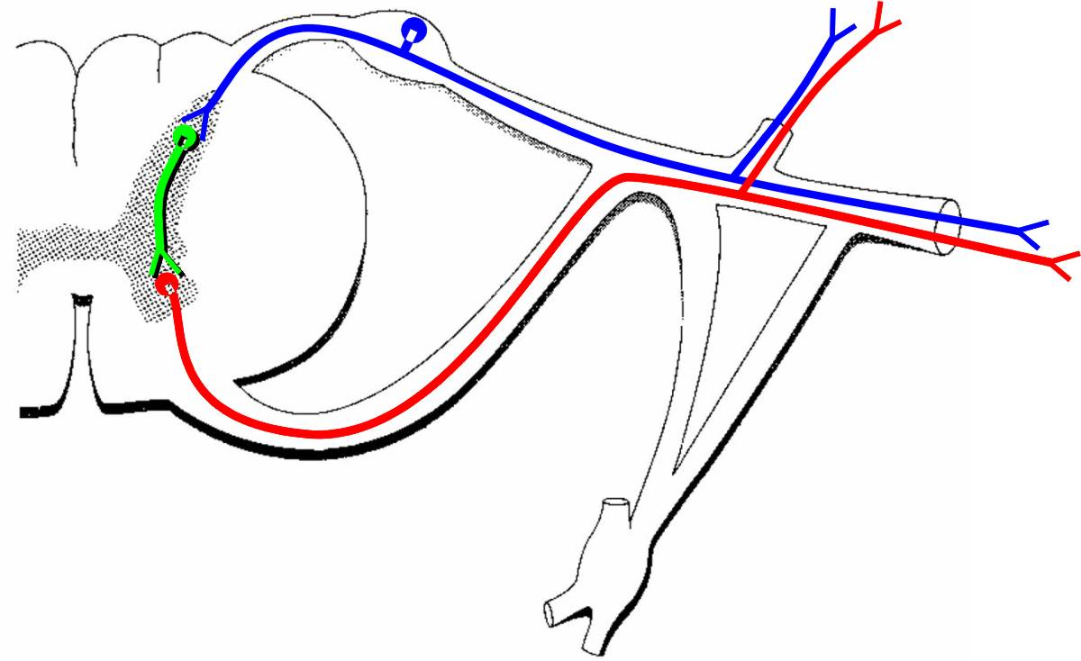
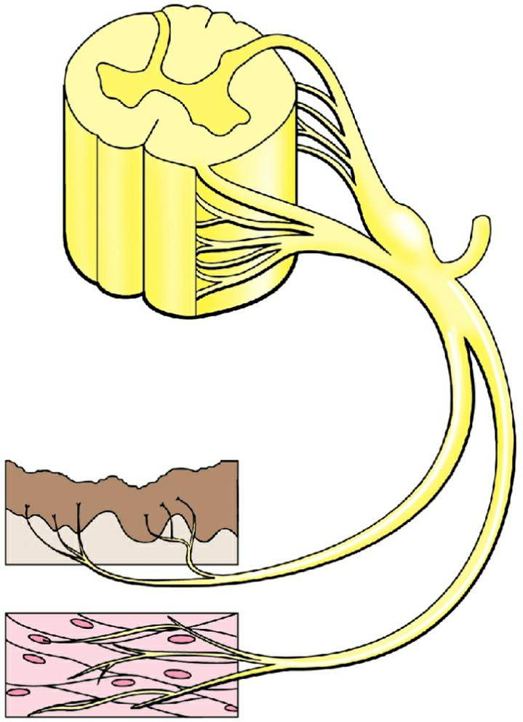
Segmental Innervation: Dermatomes & Myotomes
somatic
sensory
nerve
(GSA)
somatic
motor
nerve
(GSE)
spinal
nerve
skin
(dermatome)
Dermatome: cutaneous (skin) sensory territory of a single spinal nerve
Myotome: mass of muscle innervated by a single spinal nerve
muscle
(myotome)
Moore’s COA6 2010

Slide 18
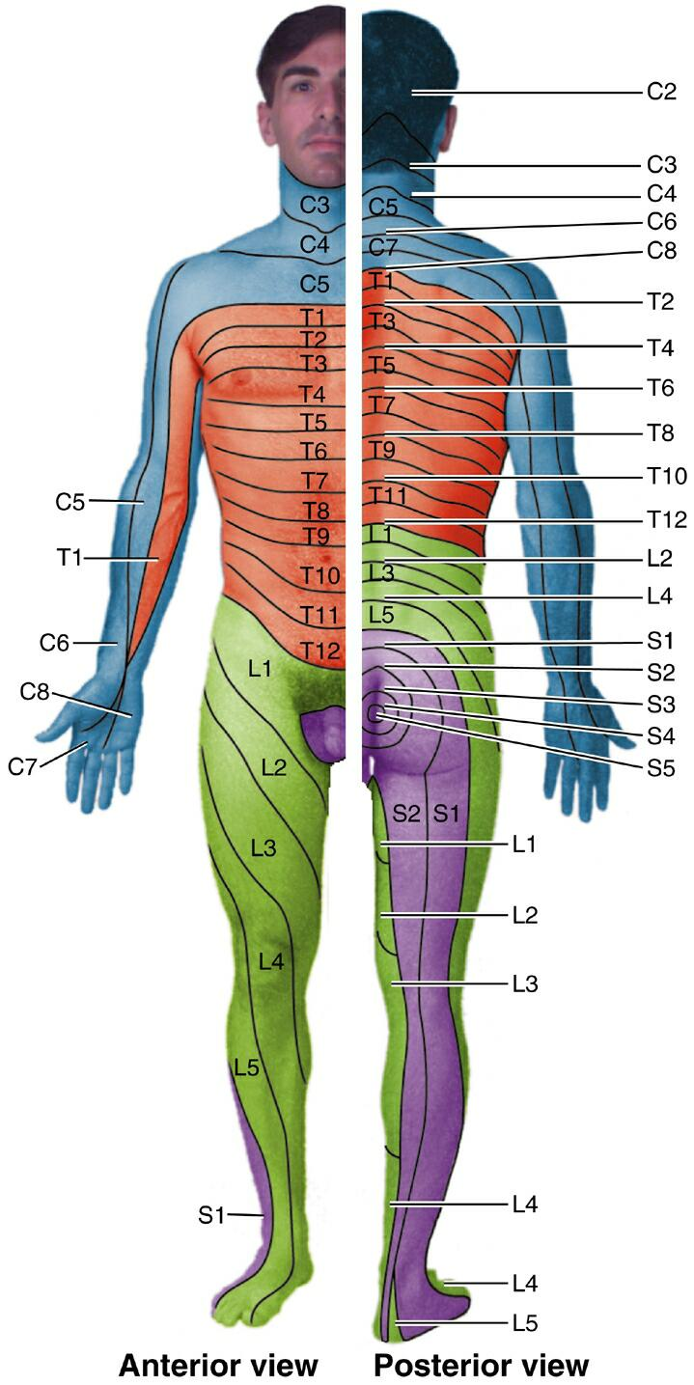
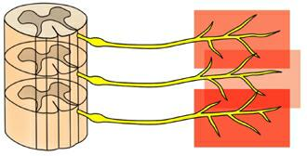
Segmental Innervation:
Dermatome Maps
• Based on clinical findings of deficits in cutaneous sensation
• Diagnostic aids: localization of lesions to cord levels
• Limits to specificity due to overlap of dermatomes
dermatome
overlap
Moore’s COA6 2010

Slide 19
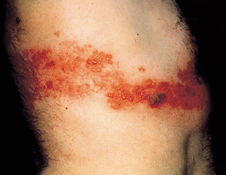
Dermatomes & Herpes Zoster (“Shingles)”
dorsal root
ganglion
• Chicken pox virus (varicella) infects dorsal root ganglia
• Once activated, travels along afferent axons to skin where it forms very painful rash
• Often has a typical dermatomal presentation

Slide 20
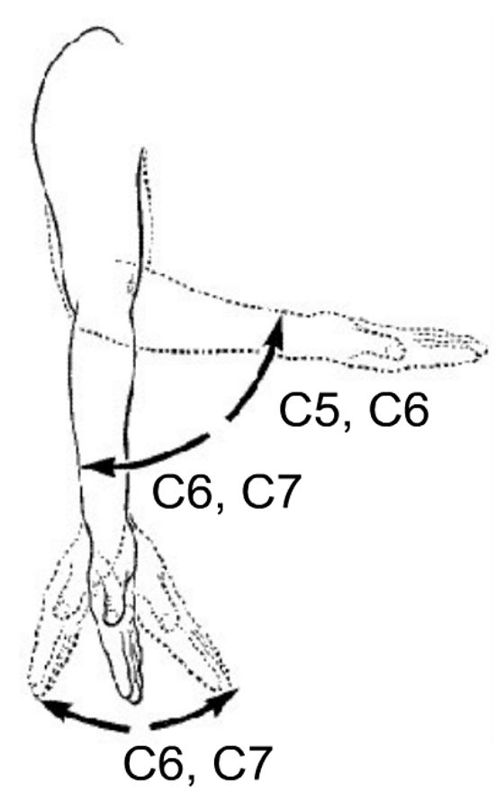
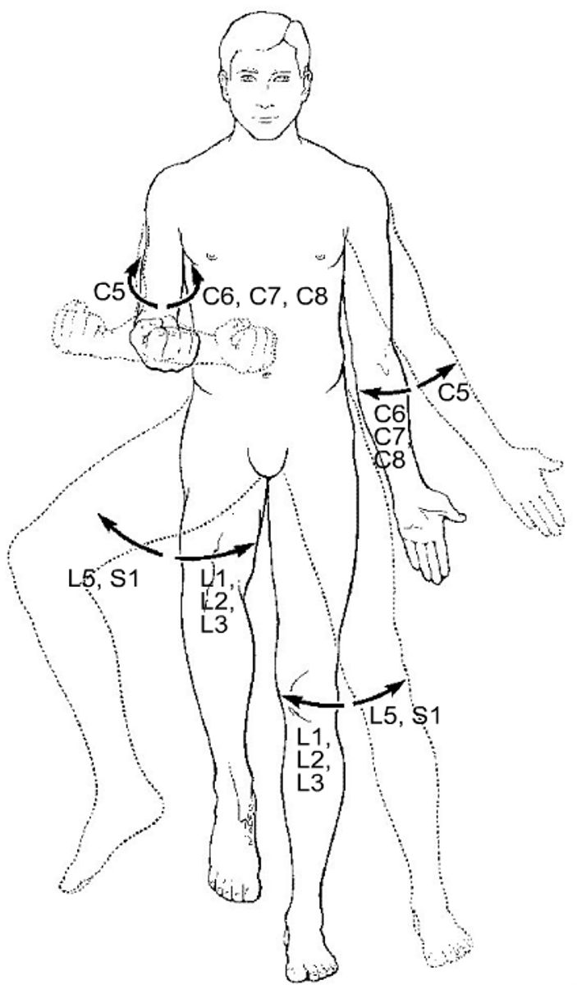
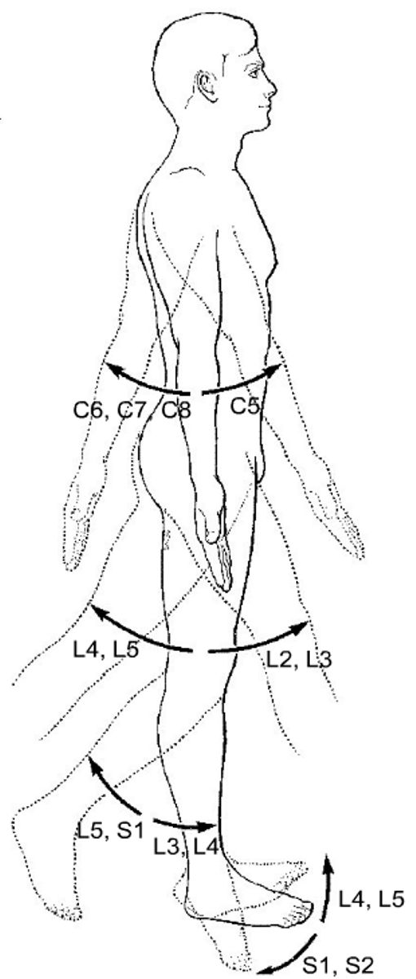
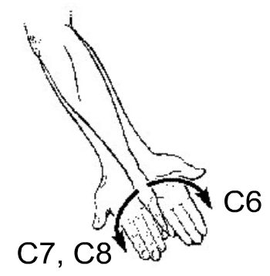
Segmental Innervation:
Myotome Maps
FLEXION
ROTATION
ABDUCTION
FLEXION
• Particular functions are linked to muscles innervated by particular cord levels
• Example: C5 lesion
• Weakness in flexion of elbow & shoulder
• Weakness in abduction & lateral rotation of shoulder
Grant’s Atlas 12 2009

Slide 21
PNS Plexus Formation
cervical
plexus
C1–C5
• Dermatomes: single spinal nerve
• Peripheral nerves: multiple spinal nerves from different cord levels
• Plexus formation: mixing of nerves from different cord levels by union and division of bundles
brachial
plexus
C5–T1
dermatome map
disparity
lumbar
plexus
L1–L4
sacral
plexus
L4–S4
map of named peripheral nerves
Moore’s COA6 2010

Slide 22
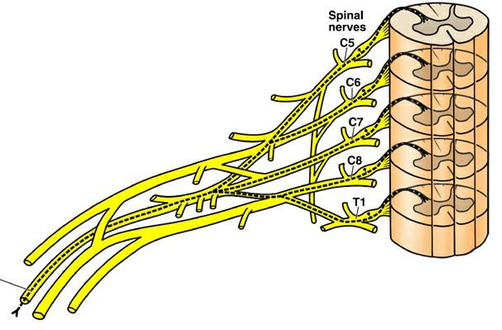
PNS Plexus Formation
Example of named peripheral nerve
Radial nerve receives fibers from spinal nerves from five different cord levels
— in fact, all cord levels of the brachial plexus
Radial Nerve
C5–T1
Brachial Plexus (C5–T1)
Moore’s COA6 2010

Slide 23
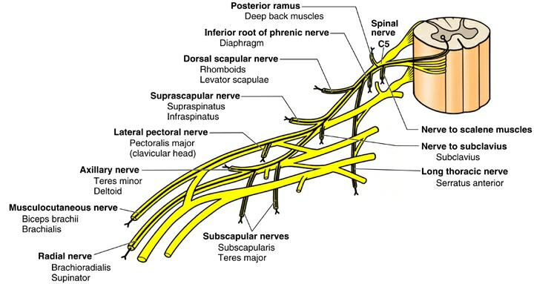
PNS Plexus Formation
• Distribution of a single spinal throughout a plexus
• Myotome — return to the C5 lesion example
ABDUCT & LAT. ROTATE
ABDUCT & LAT. ROTATE
FLEX
Abduction: supraspinatus & deltoid
Lateral Rotation: infraspinatus & teres minor
Flexion: Biceps brachii & Brachialis
Moore’s COA6 2010

Slide 24
References
Agur, A. M. R. and A. F. Dalley. 2009. Grant’s Atlas of Anatomy, 121th Edition. Lippincott, Williams & Wilkins, New York.
Bannister, L. H. et al. 1999. Gray’s Anatomy, 38th Edition. Churchill Livingstone, New York.
Moore, K. L. , A. F. Dalley, and A. M. R. Agur. 2010. Clinically Oriented Anatomy, 6th Edition. Lippincott, Williams & Wilkins, New York.
Sadler, T. W. 2004. Langman’s Medical Embryology, 9th Edition. Lippincott, Williams & Wilkins, New York.
Stern, J. T., Jr. 1988. Essentials of Gross Anatomy. Davis, Philadelphia.

