Slide 1
ART 1600, The Aesthetics of Architecture, Interiors, and Design
Matthew Ziff, Associate Professor, Interior Architecture Area Chair
Fall Semester 2015
Composing with Materials
There are fundamentally three (3) tools, (along with light)
that designers have available to create physical environments:
Form
Material
Color

Slide 2
If Design can be described as
‘Same-ness Tempered With Difference’ then we can create gradations of same-ness or difference
To make a space, or object 100% ‘match’, or ‘go with’, another space or object, we would use:
the same material
the same form
the same color

Slide 3
To make a small change between the two we could use:
the same material, the same form, but a different color.
OR
the same material, a different form, the same color
OR
a different material, the same form, the same color

Slide 4
To make a dramatic change between the two, we could use:
a different material, a different form, a different color
Sameness ------- Difference:
the degree to which these occur is a decision we make.

Slide 5
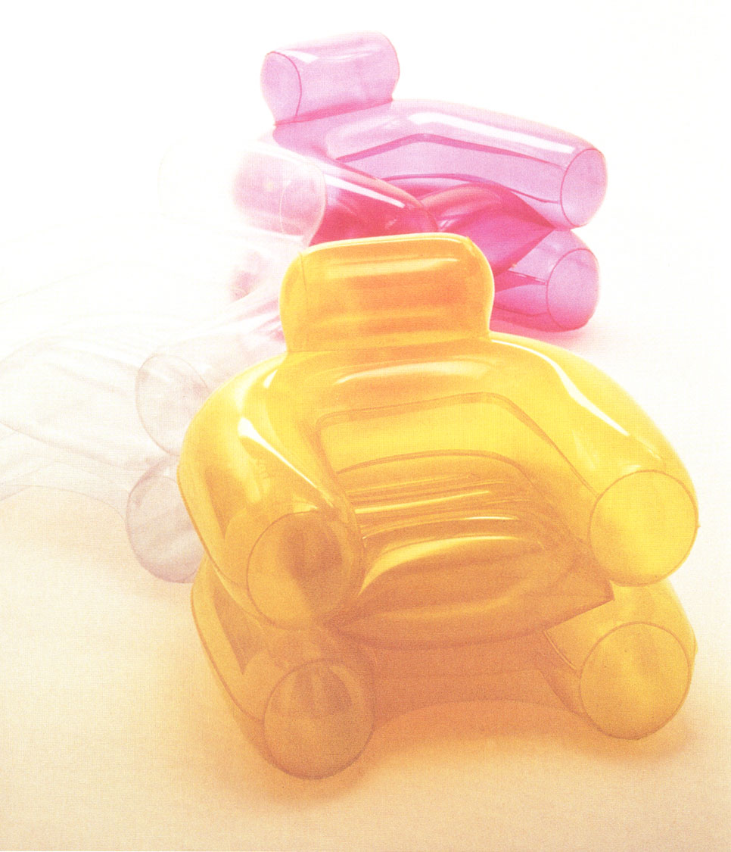
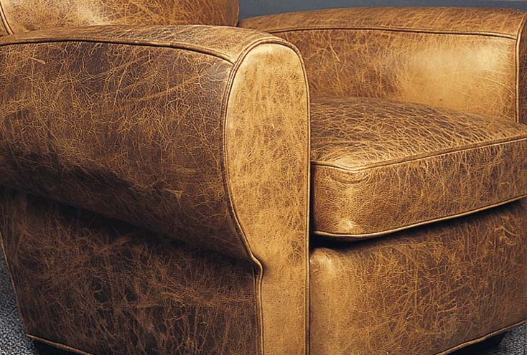
Same form, different material,
different color

Slide 6
Materials are Described by referring to:
  Texture
  Color
  Pattern
  Transparency, Opacity
  Weight
  Strength
  Warmth, Coolness
  Reflectivity
  Size

Slide 7


Same material, different color
(woven linen)

Slide 8
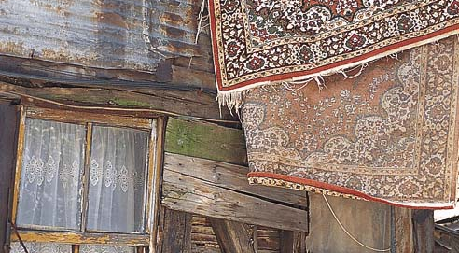
Different materials, different colors, different forms

Slide 9
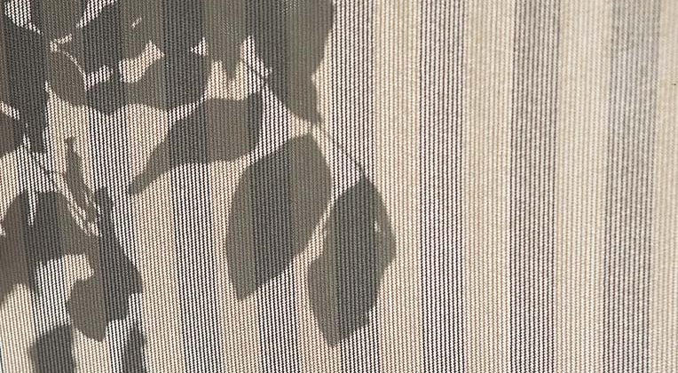
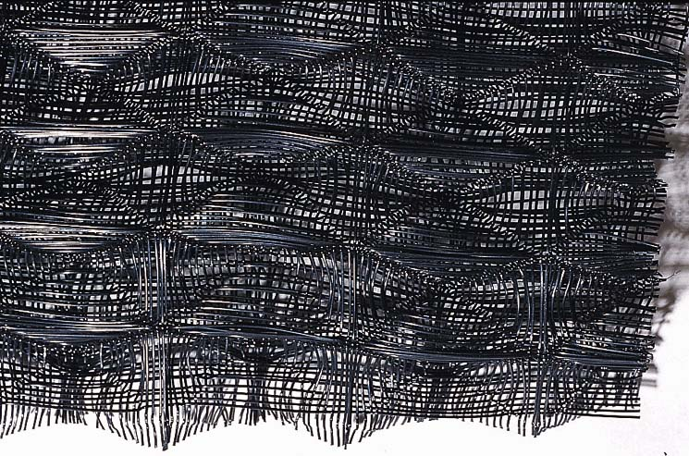
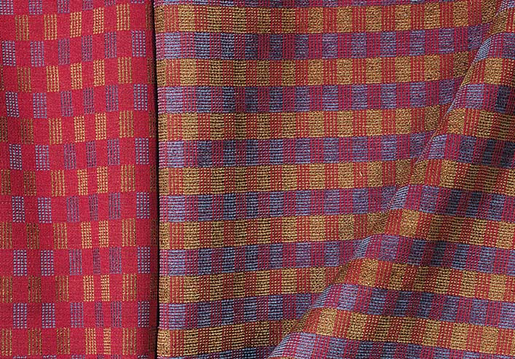
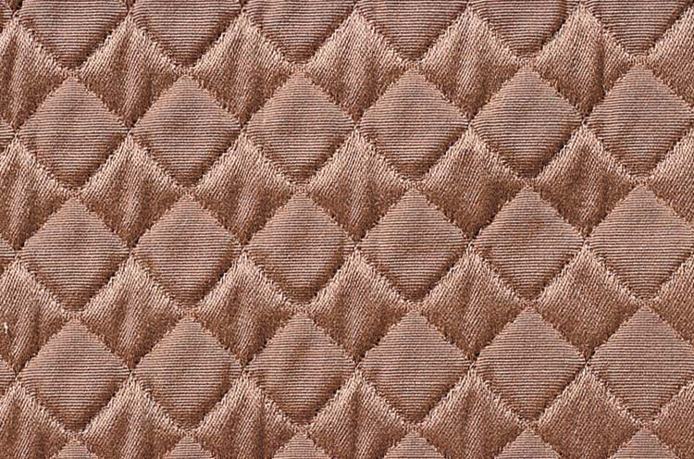
All fabrics, (textiles) but of different colors & different textures, (because of different weaves)

Slide 10
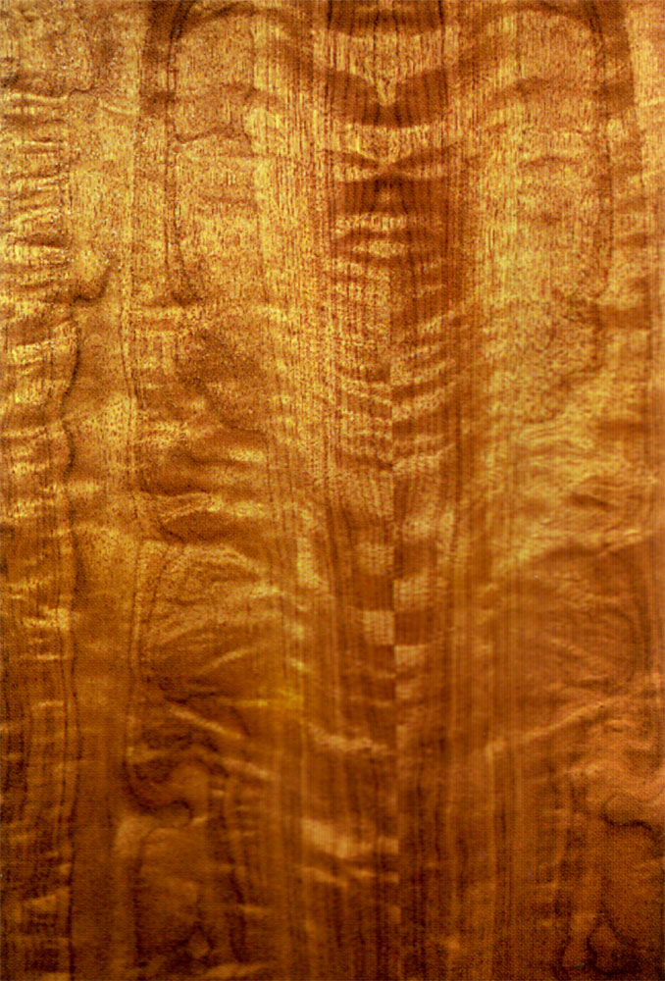
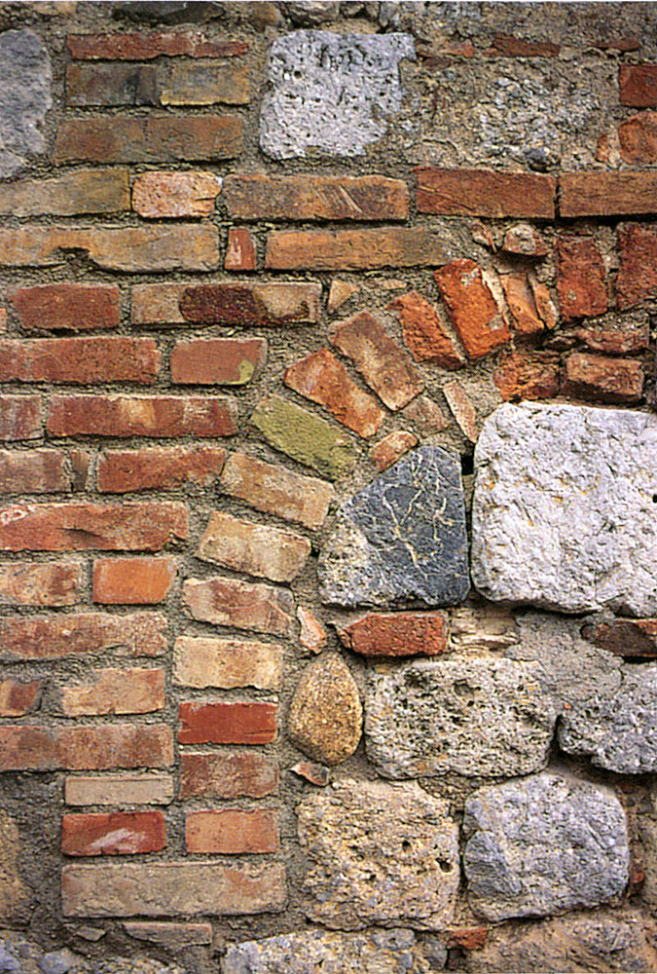
A Wood wall
or a
Brick wall:
does it
change what the wall is like?
Of course!

Slide 11
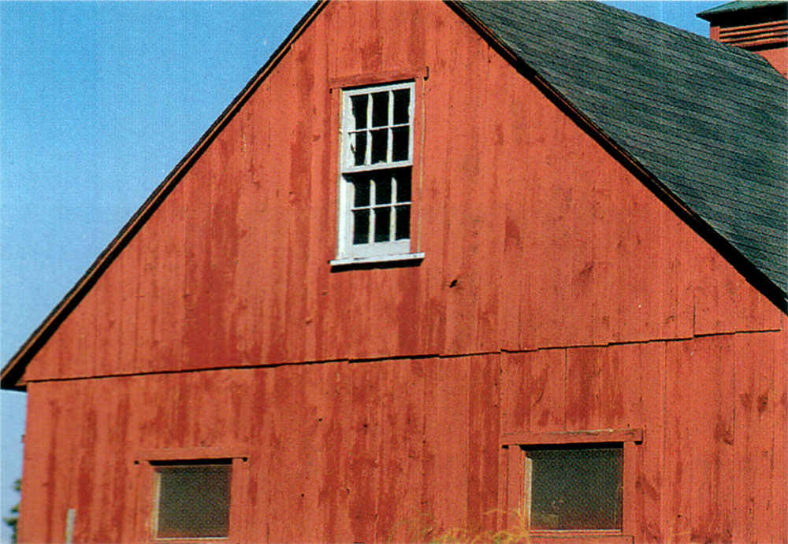

Slide 12
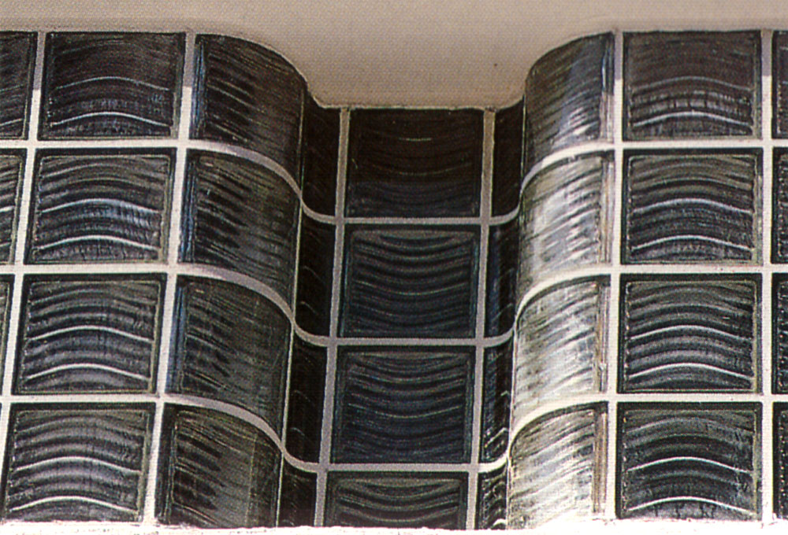

Slide 13
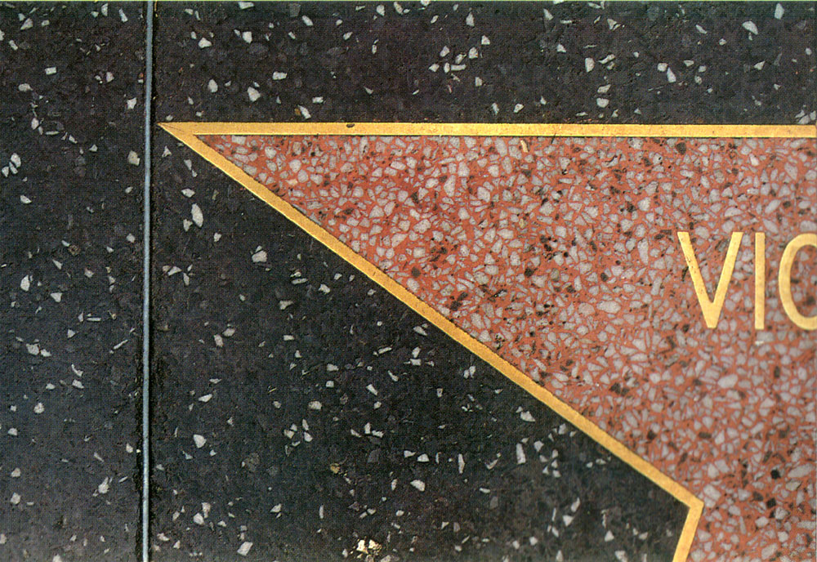

Slide 14

Terrazzo Flooring

Slide 15
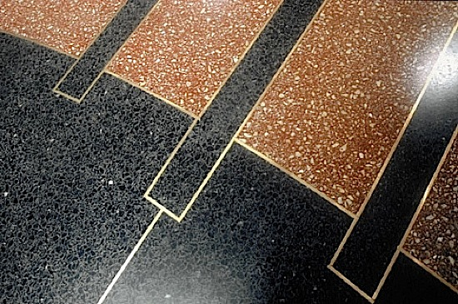
Terrazzo Flooring

Slide 16
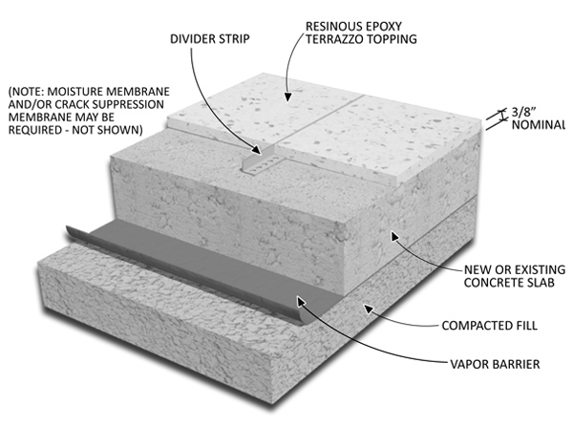
Terrazzo

Slide 17
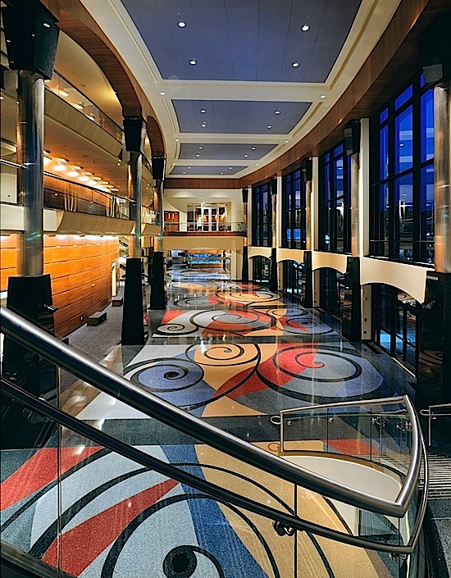
The Clay Center for the Arts and Sciences, Charleston, WV
Architect: Calloway, Johnson, Moore West, Winston-Salem, North Carolina
Terrazzo Contractor: Roman Mosaic and Tile Company, Linthicum, Maryland

Slide 18
What is Terrazzo?
In general, terrazzo is a mixture of marble chips and colored cement or epoxy that is poured into an area and given time to cure.
Each pour is contained within areas marked out with strips of metal or plastic, usually about 5/8” tall.
Once the terrazzo has hardened, it is ground down to expose the interior of the marble chips among the colored matrix.

Slide 19
How Terrazzo is installed
The process of installing a terrazzo floor begins by laying out strips that separate the different colors and patterns of the terrazzo.
Zinc, brass, plastic or aluminum strips are installed into the sand and cement underbed, or glued directly onto the concrete slab, following the artist's or architect's design.

Slide 20
How Terrazzo is installed
The cement or epoxy mixture is then carefully poured between the strips, following the architectural plans.
Different colors are poured at different times until the floor is completely covered with the mixture.
The mixture is given time to cure and harden.

Slide 21
How Terrazzo is installed
The finishing process involves grinding the top layer of the surface with a machine and filling in the air pockets with grout.
Afterwords, a polishing machine buffs the floor to a matte finish and a penetrating sealer is immediately applied in order to close the pores in the surface of the floor.

Slide 22
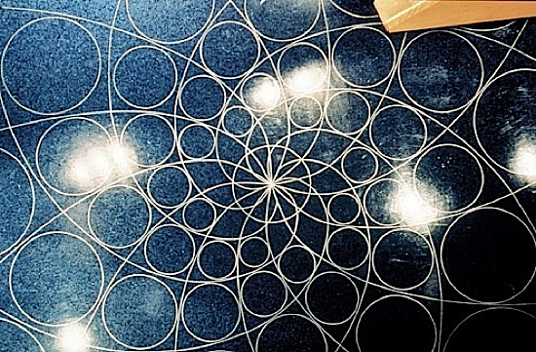
Bethesda Academy of Performing Arts, Maryland
Architect: Wood and Zapata, Boise, Idaho
Terrazzo Contractor: Roman Mosaic and Tile Company, Linthicum, Maryland

Slide 23
Terrazzo Floor Video (a 6 minute video)

Slide 24
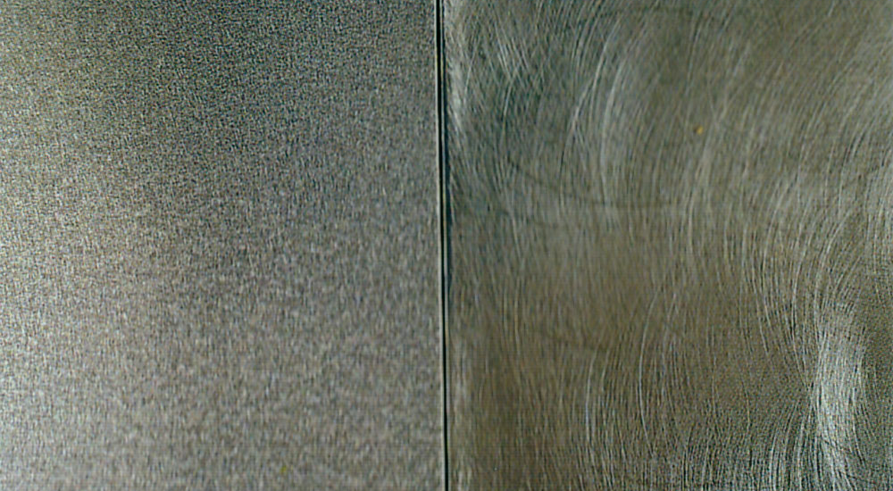
Same material, stainless steel, same color, different surface texture (shape).

Slide 25
Materials, like colors, are not inherently Good or Bad: it is in the way they are used that results in ‘good’ or ‘bad’ design.
What is the best use/application for the material?
What are the physical properties of the material and how do those constrain its use?

Slide 26
Composing with Materials
Emphasize properties of materials by placing them next to contrasting materials.
Use different materials for different components of the building.
Emphasize the beginning and ending of components of the building.
Clarify the connections between the parts of the building.

Slide 27
Composing with Materials
Contrast raw materials with refined materials.
Do not obscure the process of aging materials.
Refresh (clean or replace) materials that age quickly.
(Maintenance is important for some materials.)
Use materials in a new way.

Slide 28
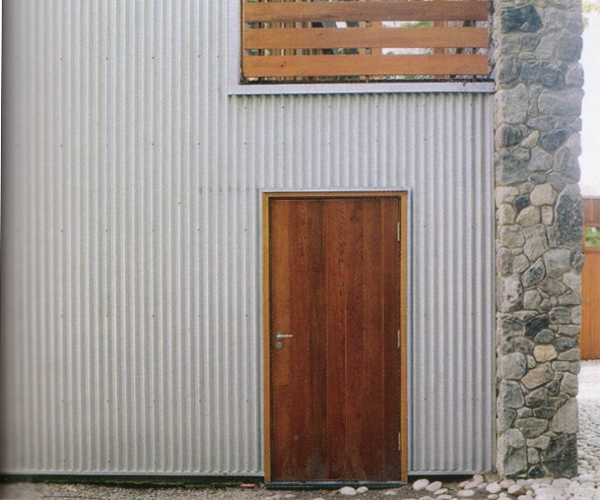
Emphasize properties of materials by placing them next to contrasting materials.

Slide 29
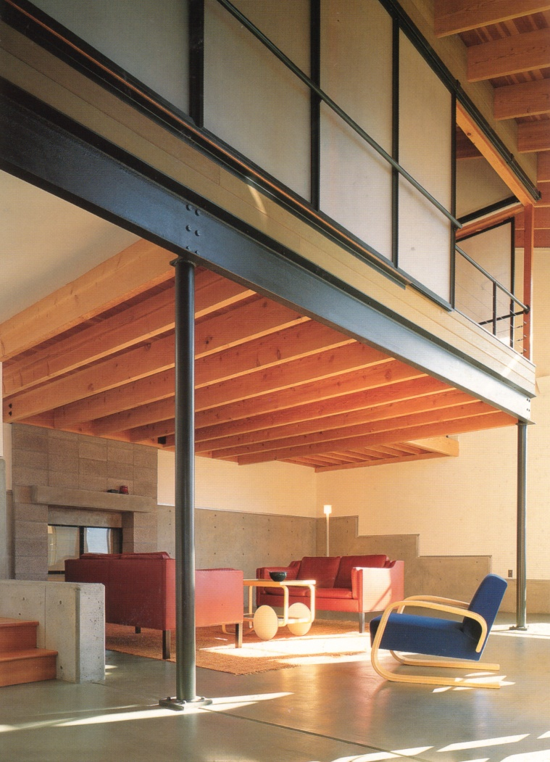
Use specific and different materials for different components of the building.
‘Structure’ vs ‘infill’

Slide 30
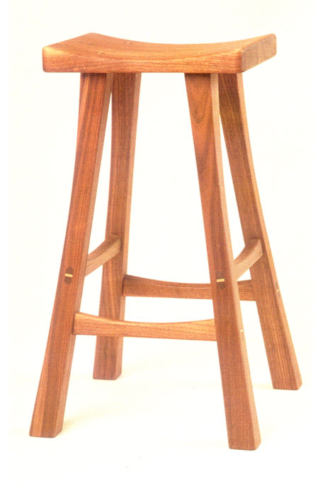
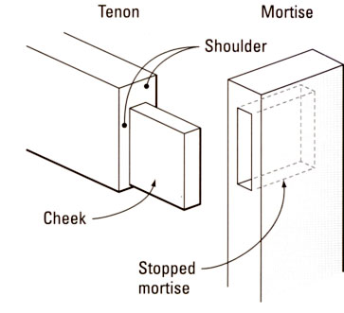
Emphasize the beginning and ending of components: details & joints

Slide 31
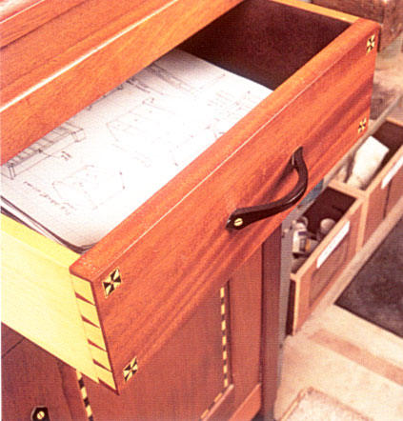
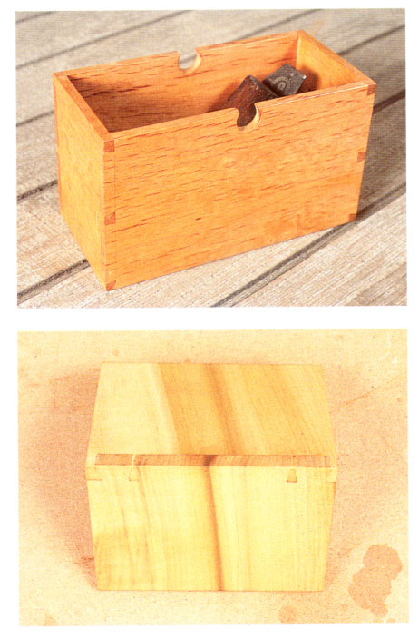
Dovetail Joints: a visual expression of the construction

Slide 32
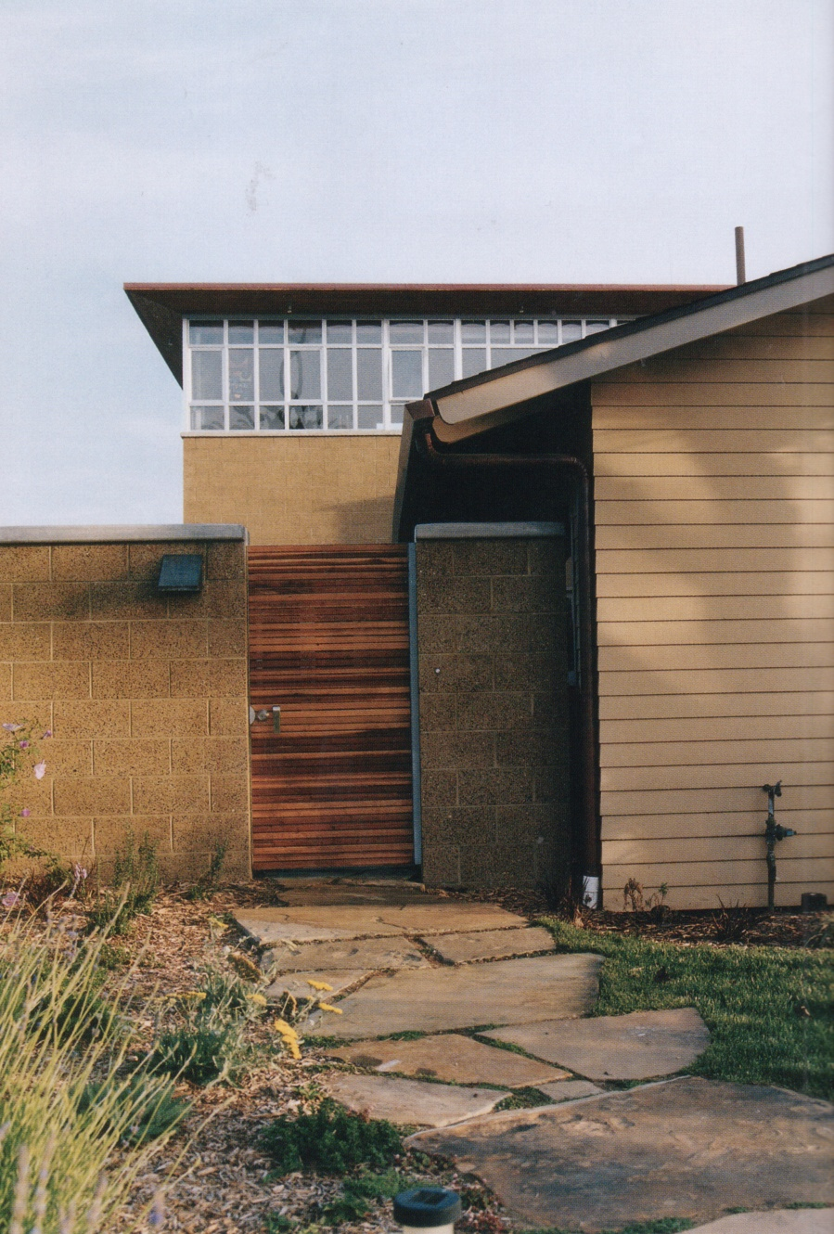
Clarify and emphasize the connections between the parts of the building.

Slide 33
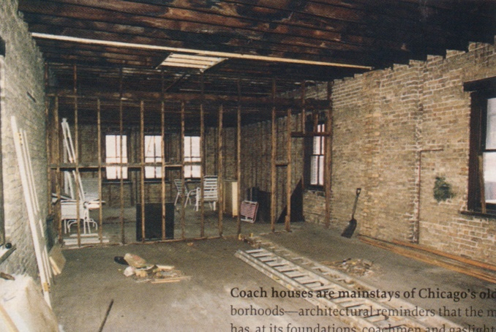
Contrast raw materials with refined materials.

Slide 34
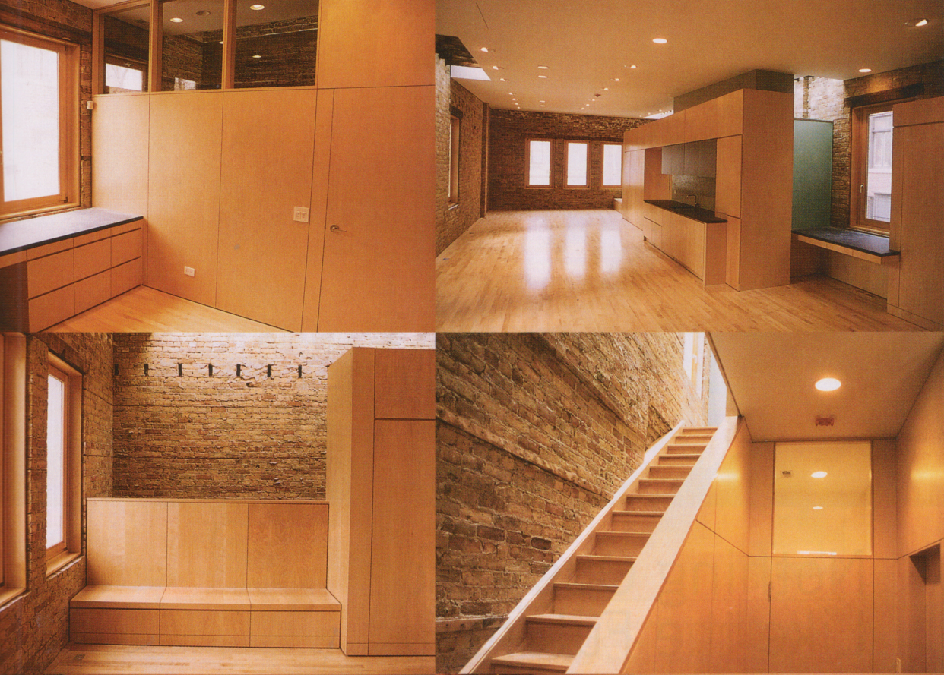

Slide 35
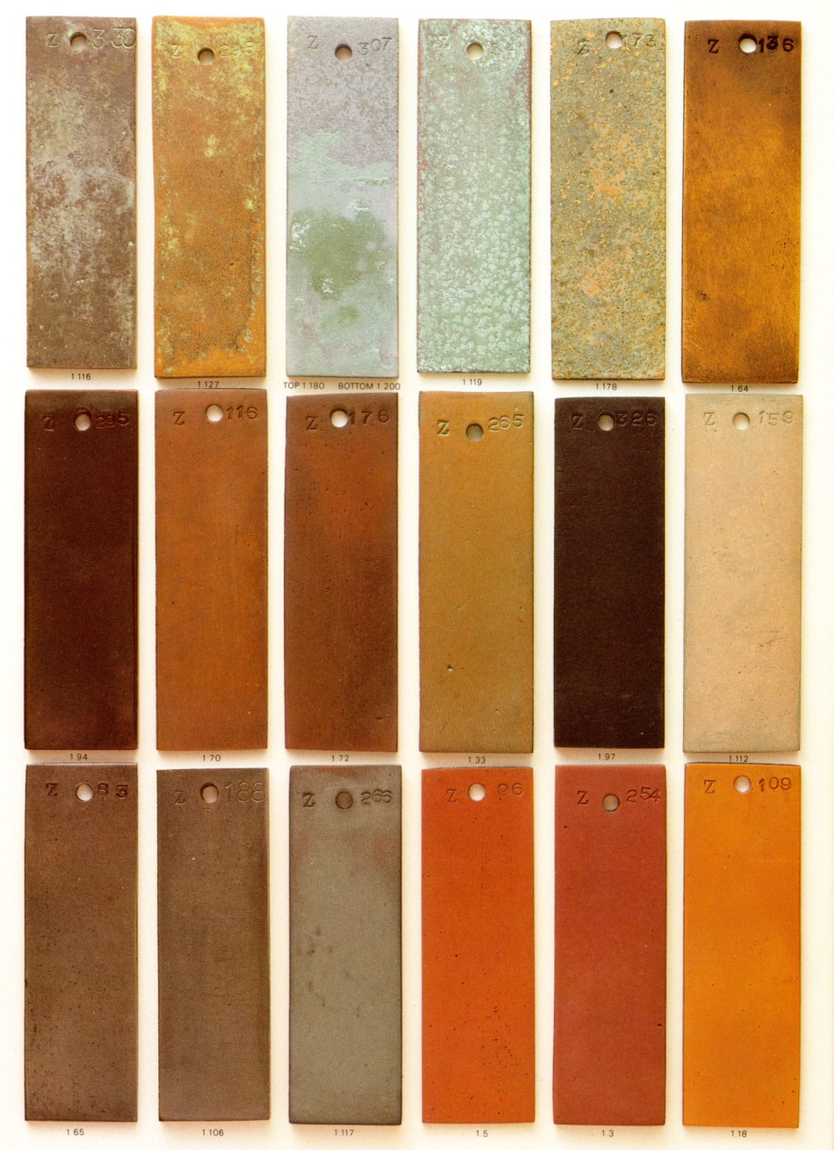
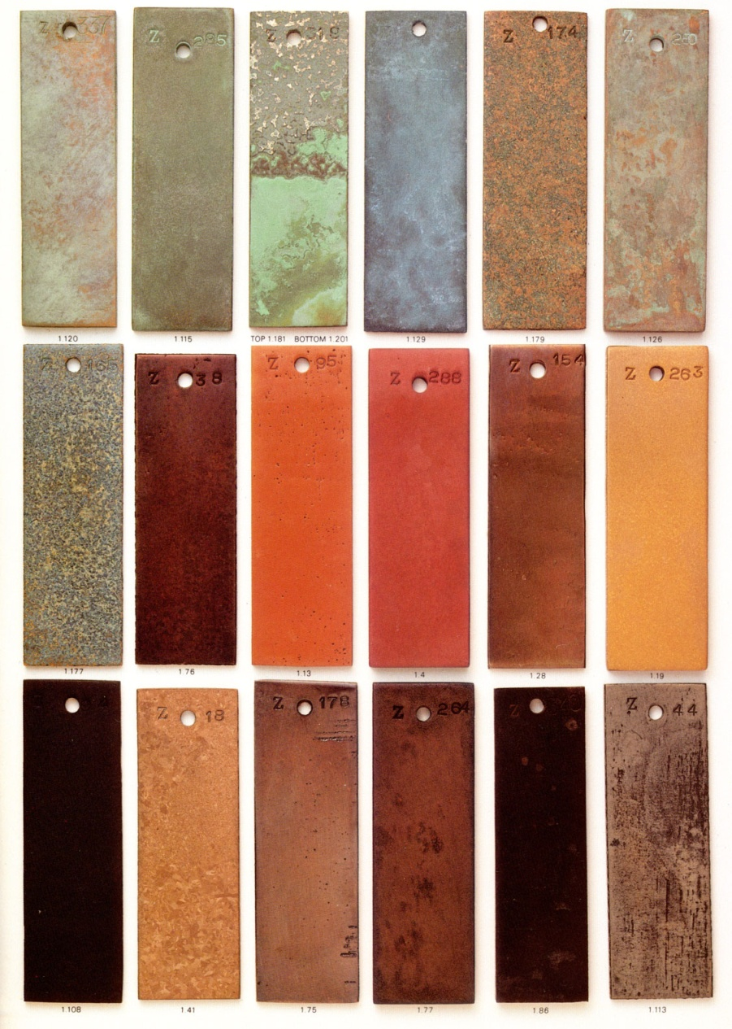
Do not obscure the process of aging materials. Old, worn, materials can have a rich aesthetic character.

Slide 36
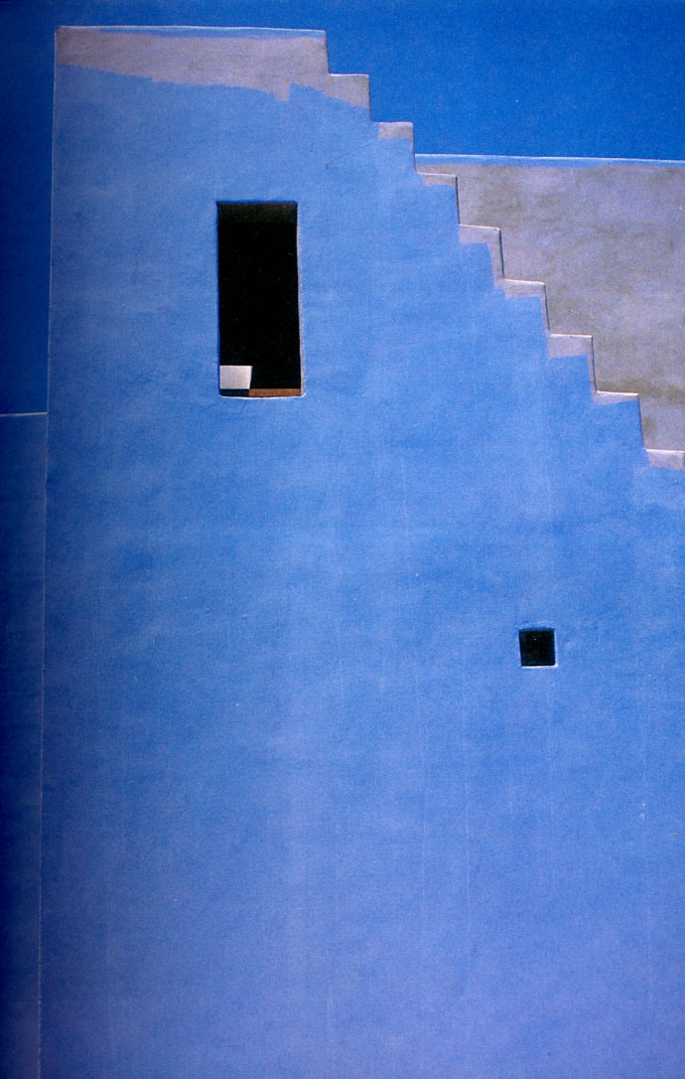
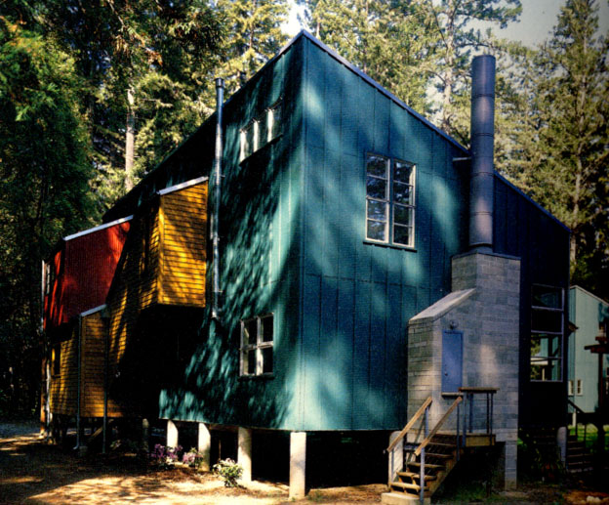
Clean or replace materials that age quickly. (Maintenance is important for some materials.)

Slide 37
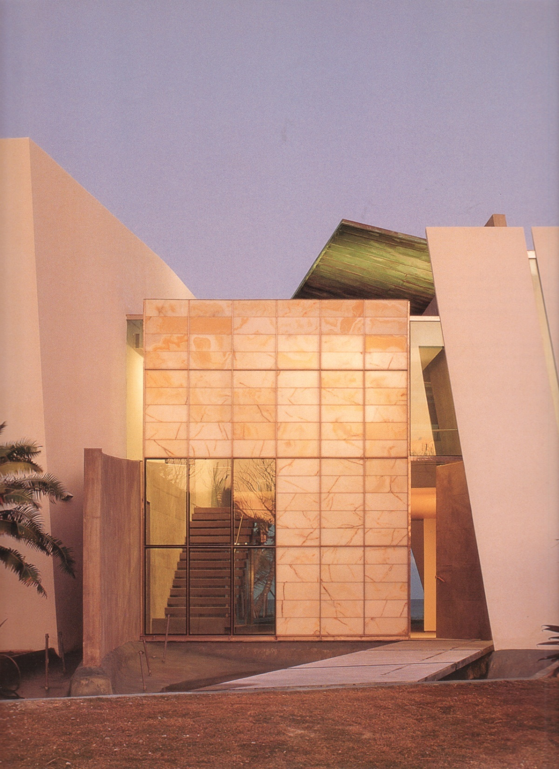
Use materials in a new method.
Enhance the appreciation of materials. Thin stone panels used in place of glass in this window wall.

Slide 38
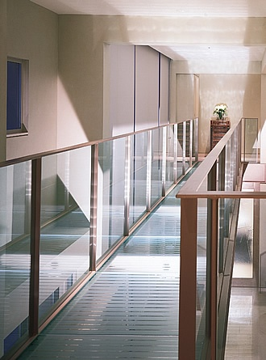
Glass used for structural components.

Slide 39
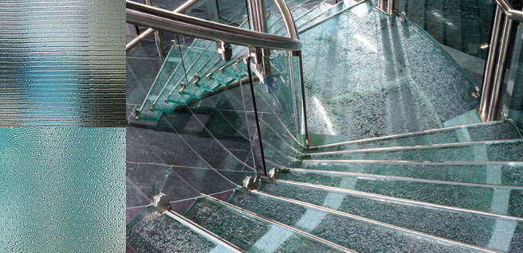
Glass used for structural components.

Slide 40
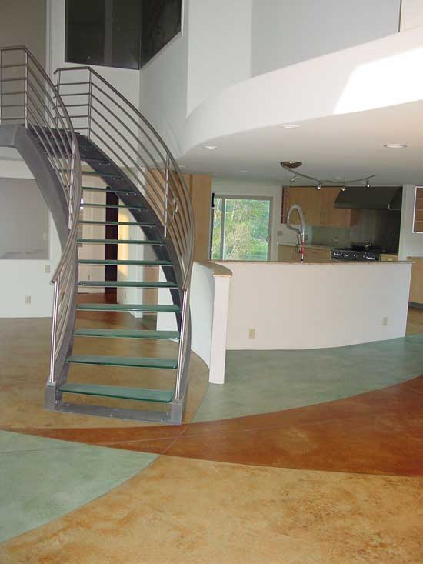
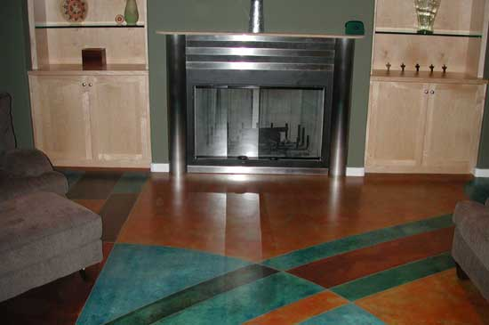
Stained and acid washed concrete floors. (Finished with wax.)

Slide 41
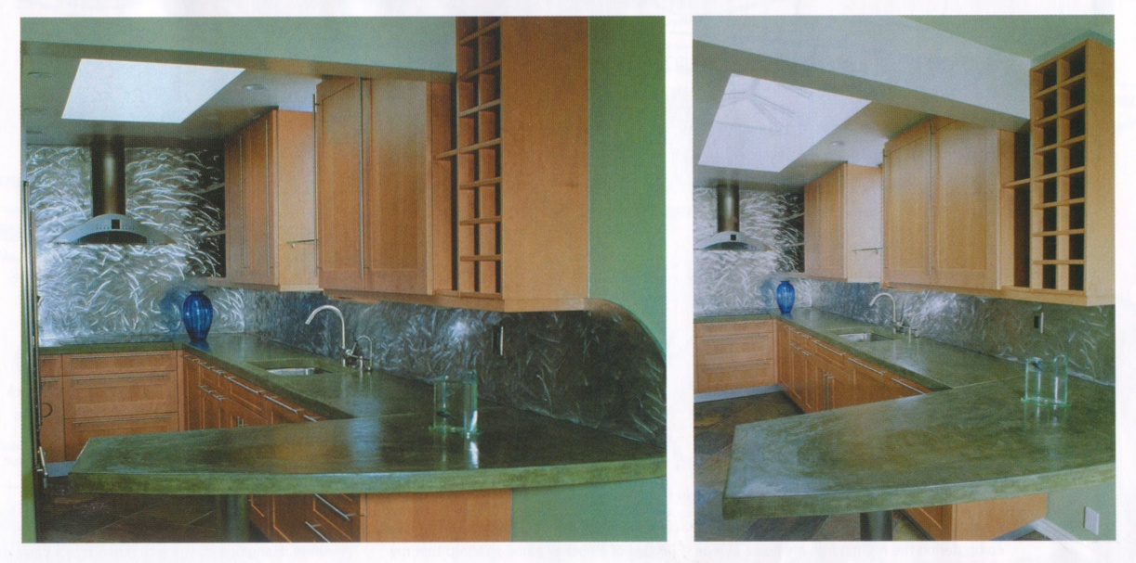
Concrete counter tops; currently popular due to low cost and easy
customization of shapes.

Slide 42
Concrete
How Portland Cement is made web page
How Portland Cement is made Video (a 5 minute video)
Concrete is often praised as being an ‘eco’ material, but a tremendous amount of energy is required to obtain (from a quarry) and then process (in a factory) the Portland cement which is the central ingredient in concrete.
Once the concrete is made, and hardens, yes, it is clean, it does not ‘offgas’ and it is long lasting, all of which is important and ‘eco’.

Slide 43
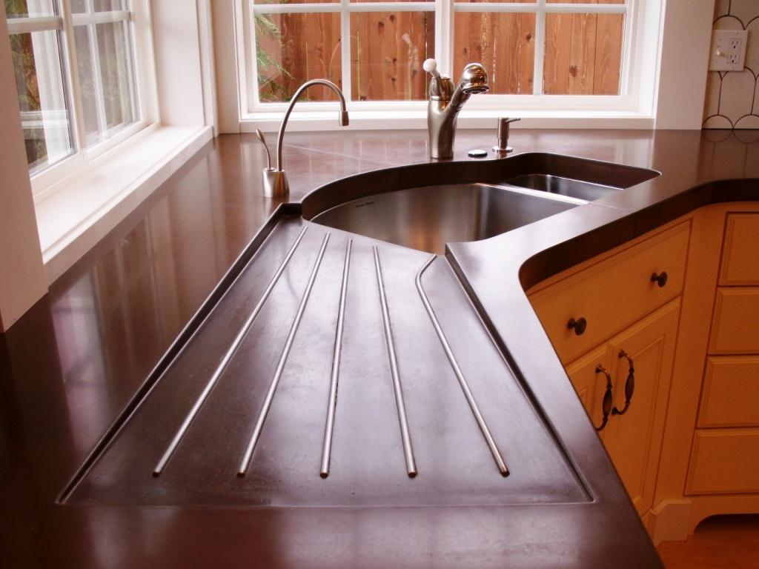
Concrete countertop the drain area is formed into the concrete when it is cast

Slide 44
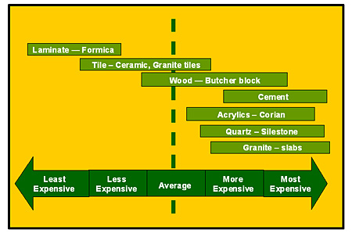
kitchen counter top price comparisons

Slide 45
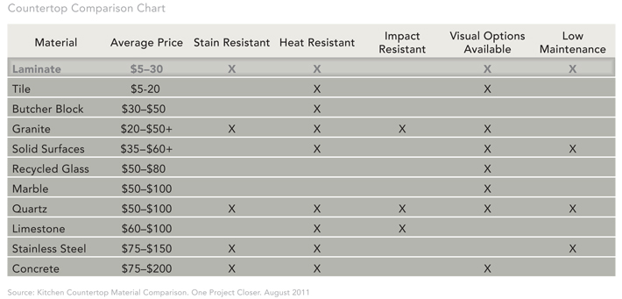
kitchen counter top price comparisons

Slide 46
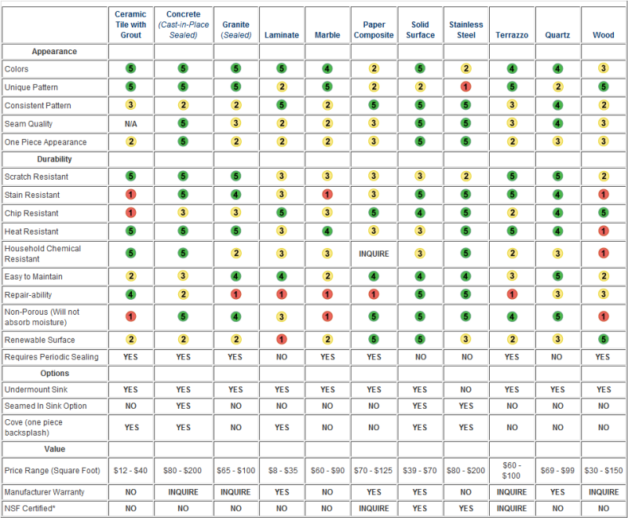

Slide 47
The cost of an architectural, interior design, element, such as a kitchen counter top is determined by several factors
labor cost: how much time and effort is required to make/install
who does the work? skilled craftsmen? unskilled laborers?
material cost: how much does the material itself cost, what is the possible price range: is a material available used, at auction?
what size/thickness/quality of material is involved?
do you need ‘the best’ piece of granite? Brazilian granite? North Carolina granite?
Does it need to be ¾” thick, 3” thick?
There is a big cost difference in thickness of stone.

Slide 48
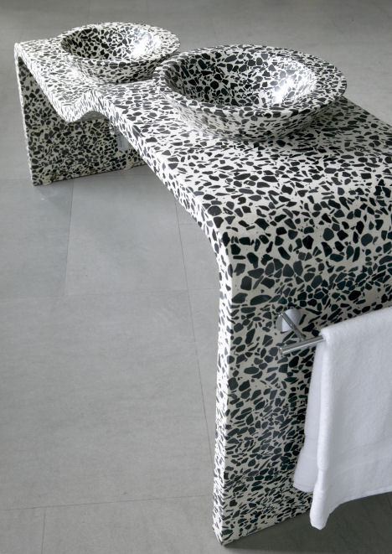
Terrazzo Concrete Vanity Top and Bowls

Slide 49
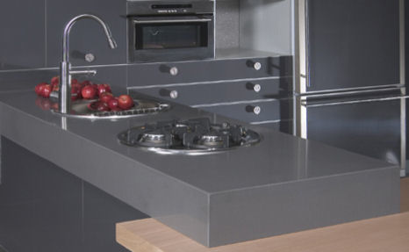
Concrete countertop

Slide 50
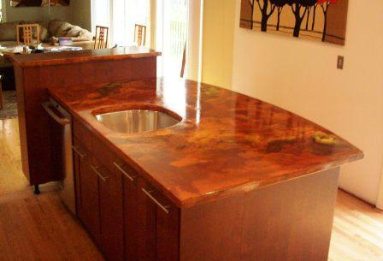
Stained concrete counter top

Slide 51
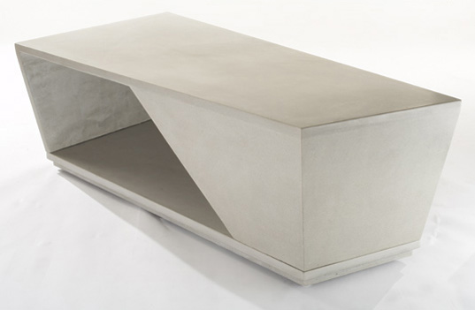
ASKEW Concrete Table by Oso Industries

Slide 52
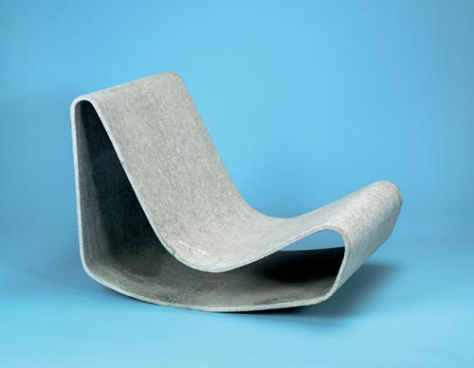
‘Concrete Chair’
Design by Willy Guhl, 1954
Manufacturer Eternit AG

Slide 53
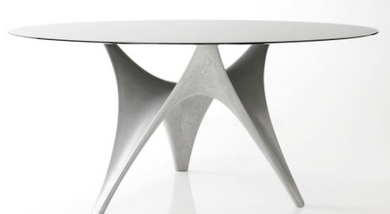
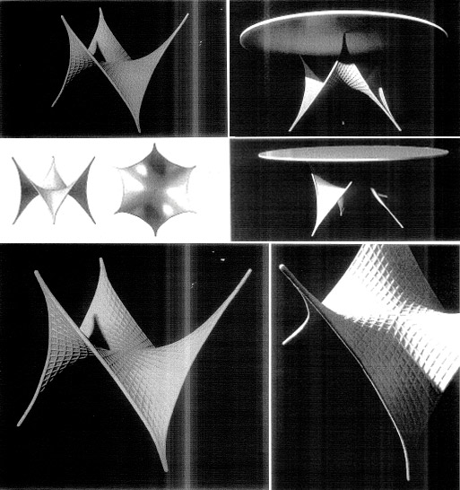
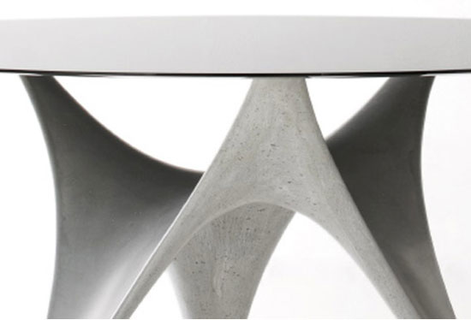
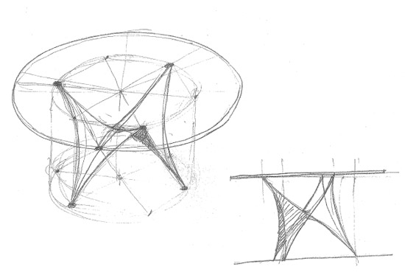
Arc Table, designed by Foster+Partners made of a composite material of cement and organic fibers, strong, elastic and impermeable.

Slide 54
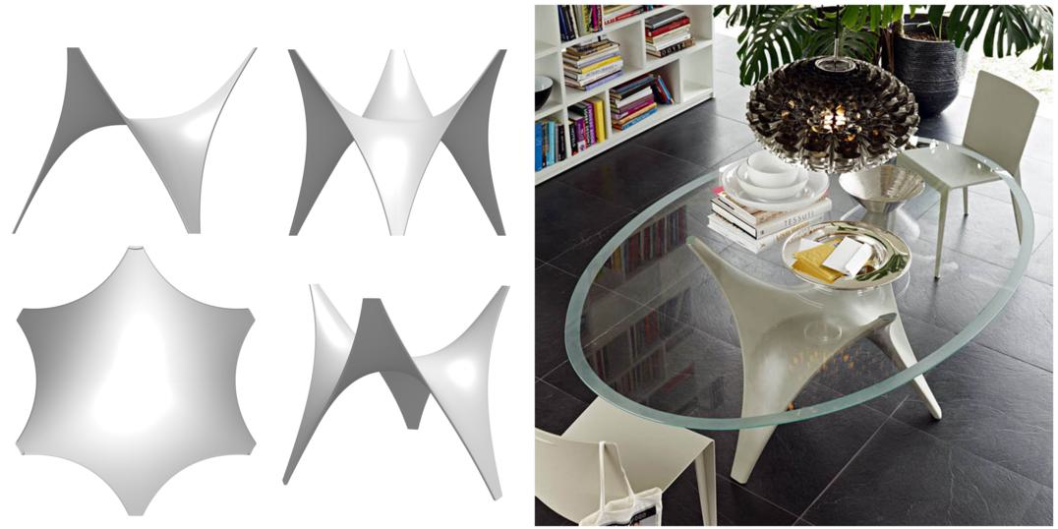

‘Arc’ table made of fiber reinforced cement
(which is like concrete, but without the ‘aggregate’/stones)

Slide 55
The Arc Table was developed by Foster + Partners Product Design Group for Molteni.
The Specialist Modeling Group worked closely on the project creating the digital tools to generate the form and link these design tools to the fabrication process.
I wrote a computer program based on the structural dynamic relaxation algorithm of Dr. Chris Williams of the University of Bath.
This form finding tool was used to generate many different table options.
These options were then 3d printed using the office's rapid prototyping machines.

Slide 56
The generating script was constantly modified during the design process.
The natural-looking curves of the form-found shape were generated by the algorithm, however, this algorithm was constantly adjusted to new design considerations.
For example, the raised height of the center of the table was achieved by adding a negative gravity to the structural nodes of the mesh.
A separate complex algorithm was written to calculate the structural thickness of the surface.

Slide 57


Materials: Bring outside materials to the inside

Slide 58

Rough and Smooth components contrasted with refined, finished components.

Slide 59

Structure and Finish: The actual structural material can also be the finished surface that we see.

Slide 60


This could be an actual stone bearing wall or it could be stone facing on top
of a concrete wall.
Still, the substantial, solid, and heavy quality of the stone contrasts
with the finish of the wood and stainless steel.

Slide 61


Ceramic tile can be used to produce complex patterns and color fields.

Slide 62



Slide 63


Bisazza Tile
An Italian tile company specializing in glass mosaic tile

Slide 64

A table lamp, by Plug, made using Bisazza glass tile

Slide 65

The wood of the ceiling is used in long, linear, visibly distinct pieces.

Slide 66

Let the design respond to standard sizes of materials.
Nearly all materials are manufactured in ‘standard’ sizes.
Use the standard sizes in creative ways before demanding ‘custom’ manufactured products.

Slide 67

Metal tubing, including steel,
aluminum, and copper are
manufactured in a vast array of
shapes and dimensional sizes.

Slide 68
Many building materials are manufactured in a range of Standard Sizes
Panel products, such as plywood, particle board, masonite, fiber board, gypsum board, fiberglas sheets, insulation boards, et cetera are all made in 4’ x 8’ sizes.
(other sizes of these materials are often made as well, but 4’ x 8’ remains the most common ‘standard’ size).
Using the standard sizes will reduce both material cost and labor cost.

Slide 69
Standard size vs Custom
Imagine a designer proposes that a gypsum board, or veneer plywood, wall panel is to be installed with a module size of 47” wide, across all of the walls of a room.
This means that the contractor is going to have to cut 1” off the width of a 4’ (48”) wide sheet of plywood, or gypsum board.
This takes time (labor cost) and wastes material.

Slide 70

some standard sizes (6’-8” x 32”x 1 3/4” thick) of hollow metal doors

Slide 71

standard size and ‘design’ of doors

Slide 72

He wishes this door was better designed to meet his needs!

Slide 73

standard, 6’-8” x 32” wood interior door
This is a ‘standard’ simply because it is widely accepted and it works reasonably well for most applications.

Slide 74

Standard size door

Slide 75

standard size doors: nicely made: high quality materials, good craftsmanship

Slide 76

Unusual, one of a kind, size and design

Slide 77

One of a kind door

Slide 78

Standard size doors

Slide 79



a specialized door: particular user needs considered

Slide 80

a 48” wide front door allows furniture and appliances to easily pass through: this is a GOOD design idea!

Slide 81

a 48” wide front door!

Slide 82

a ‘custom’ designed door

Slide 83


pivot hinge doors these are like movable walls

Slide 84

a large visual entry but it will still be difficult to move a sofa through this door opening because the door itself is only 36” wide.

Slide 85


Computers and Materials

Slide 86
CNC machines
(Computer Numerical Control)
CNC machines are automated milling/cutting machines that make industrial components without human assistance.
This is possible because CNC machines are fed a series of instructions that are delivered to an internal computer controller.
These instructions are in the form of codes that belong to the numerical control programming language.

Slide 87
Computer Numeric Controlled (CNC) machines make it possible to create amazingly complex and very precise building components
CNC Machine Makes A Wood Cabinet (a 4 minute video)
CNC Cutting Alucobond Panels (a 4 minute video)

Slide 88




Slide 89

Computers were absolutely required to create this undulating, irregular structure by Frank Gehry.

Slide 90

and this one… the Guggenheim Museum, Bilbao, Spain

Slide 91

but not this one.
Notre Dame du Haut, located in Ronchamp , designed by Le Corbusier, 1954

Slide 92


Reclaimed and Recycled Materials

Slide 93



Recycled and Reclaimed materials have created an aesthetic of age, of patina, and of historic materiality.

Slide 94

End table made from mazazines, rolled up and finished with a water proof sealer.

Slide 95

Simple wood benches made from reclaimed wood boards.

Slide 96

recycled elements

Slide 97

California House designed by Fernau & Hartman Architects

Slide 98

composing with materials

Slide 99


Slide 100


Slide 101
Inside, the major wall material is a refined type of dense and smooth pre-stained plywood called Fin-Ply.
The panels are screwed onto the walls with narrow open joints between panels and the ceiling.
This plywood is so dense that, unlike conventional plywood, the cut edge retains its integrity and can be exposed, as in its use as window trim.

Slide 102

Ice Hotel X, Copenhagen, Denmark

Slide 103

‘Snow Village’ Montreal

Slide 104


Slide 105


Slide 106
Materials help express, or communicate, the essential character of a building.
Materials that can be used as both structural and finish surfaces help to clearly express the elegance of structural components, and their importance.
Many materials are manufactured using complex technologies and huge industrial facilities.

Slide 107
Glass, as a material used for architectural functions is a material that is produced in this way.
PPG Glass Manufacturing Video (a 4 minute video)
PPG Glass Manufacturing Video Part 2 (a 3 minute video)
Pilkington Glass Manufacturing Video (a 9 minute video)
John Pilkington invented the ‘float glass’ manufacturing process in 1959.

Slide 108



Dale Chihuly, Glass Artist

Slide 109
Dale Chihuly is an internationally known artist who works with glass
Dale Chihuly Glass Artist Video (a 5 minute video)

Slide 110
Types of Glass
Tempered Glass
Laminated Glass
Insulated Glass
Reflective Glass
Pattern Glass
Wired Glass Fireproof Glass

Slide 111

Tempered Glass
The process of creating tempered glass is to heat the original glass to a high temperature and cool it down rapidly to form surface compression on the surfaces of the glass.
Tempered glass is 3-4 times as strong as regular glass. Broken by an external force, it will become bean-sized pieces, preventing injury to people.

Slide 112

Laminated Glass:
Laminated glass is a combination of two or more glass sheets with one or
more interlayers of plastic (PVB) or resin.
In case of breakage, the interlayer holds the glass fragments together.

Slide 113
Laminated glass
Laminated Glass is manufactured by permanently bonding two or more lites of glass with layers of polyvinyl butyral (PVB) interlayer, under heat and pressure, to create a single construction.
Laminated glass is used where safety is a priority, such as in automobile windshields, and overhead skylights.

Slide 114

Insulated Glass
Insulated glass is a prefabricated unit made of two or more glass sheets with an aluminum frame which are edge-sealed together with a sealing compound.

Slide 115

Reflective Glass
Reflective glass refers to coating the surface of the glass with one or many
layers of metal, alloy, or metal compound film to effectively control the
transmission of visible lights and low infrared.
In light of the different performance, the reflective glass can be classified into the
following:
heat-reflecting glass, low-emissivity glass (low-E), electro pane, etc.

Slide 116


Pattern Glass
Pattern glass is produced by coating and rolling clear or body-tinted, translucent clear, flat glass.
The glass is heated to its softening point and passed between two rollers, which emboss the pattern
into the glass.
It not only provides function of visual screen but also creates aesthetic senses of changing
lights and shades.

Slide 117

‘Obscure’ glass is the term used for any glass that distorts the view.

Slide 118

‘Obscure’ glass

Slide 119

Wire Glass
Wired glass is a product in which a wire mesh has been inserted during production.
A steel wire mesh is sandwiched between two separate ribbons of semi-molten glass, and then passed through a pair of metal rollers which squeeze the "sandwich of glass and wire" together.
It has impact resistance similar to that of normal glass, but in case of breakage, the mesh retains the pieces of glass.
This product is traditionally accepted as a low-cost fire rated glass.

Slide 120

Bullet resistant glass

Slide 121

Tempered Glass (a 3 minute video) shatters into harmless chunks rather than into dangerous knife shapes as non-tempered glass does.

Slide 122
All-glass buildings blur the boundaries between outside and inside.
Transparency satisfies our curiosity about the inner workings of things and assures us of the contents of a room.

Slide 123

Corning Museum of Glass, Corning, NY

Slide 124


Slide 125


Slide 126


Slide 127

A steel connector & a drawing of the same these are called ‘spiders’

Slide 128


A ‘spider’ metal connector piece

Slide 129


Galleria, Toronto, designed by Santiago Calatrava

Slide 130


galleria, toronto, canada designed by santiago calatrava

Slide 131


designed by Santiago Calatrava

Slide 132


designed by Santiago Calatrava

Slide 133


Tabourettli Theater, Zurich, Switzerland, designed by Santiago Calatrava

Slide 134


designed by Santiago Calatrava

Slide 135


designed by Santiago Calatrava

Slide 136


Glass provides light, surface, and color in interior architecture

Slide 137

Naturally colored glass is composed of 72% silica, 15% soda, 10% lime, and 3% other impurities. silica is basically sand.

Slide 138
Glass is not naturally colorless. Beach sand invariably contains black particles of iron oxides scattered through it.
When fired in a usual, oxygen-rich environment (i.e., with the furnace in an oxidizing state), these impurities give the glass a natural aquablue
to light green tinge.

Slide 139


Slide 140


glass stairways

Slide 141


Laminated glass applications

Slide 142


Details within glass stair construction

Slide 143

connecting glass pieces to other glass pieces, or connecting glass pieces to other building parts requires careful, and often sophisticated, detailing.

Slide 144

here the steel column and beam structure of the building is separated from the glass enclosing planes by building an additional light structure just for the glazing.

Slide 145

the glass is virtually invisible, allowing the unusual, and dynamic, steel structure to be seen as a whole wall.

Slide 146

‘glass box’ house designed by ken yokogawa, located in kobe, japan the interior seems to be pulled to the outdoors because of the large expanses of clear glass

Slide 147


Slide 148

floor plan of ‘glass box’ house

Slide 149


here the clear glass exterior ‘walls’ of the house disappear. this sort of application only makes sense for a site that offers substantial privacy.

Slide 150

wood framing for the fixed glass panels, operable ‘sash’, and doors.

Slide 151


Slide 152

The design firm 3deluxe created this building for the brand Leonardo

Slide 153
The design firm 3deluxe created this building for the brand Leonardo
LEONARDO is a German glass company founded in 1859.
Bringing new meaning to the concept of a showroom, the recently completed Glass Cube, designed by 3deluxe architects, is part of a strategic development plan for the company, who believe glass is the way of the future.

Slide 154

The design firm 3deluxe created this building for the brand Leonardo

Slide 155

The design firm 3deluxe created this building for the brand Leonardo: these odd shaped vertical elements are actually structural columns!

Slide 156


The design firm 3deluxe created this building for the brand Leonardo

Slide 157


The design firm 3deluxe created this building for the brand Leonardo

Slide 158

The design firm 3deluxe created this building for the brand Leonardo

Slide 159

‘The Glass House’, 1949 designed by
Phillip Johnson located in New Canaan, Connecticut

Slide 160

‘The Glass House’ designed by Phillip Johnson, 1949

Slide 161

‘Farnsworth House’, 1946-1950 designed by
Ludwig Mies Van de Rohe located in Plano, Illinois

Slide 162


Concrete infused with glass fibers light is transmitted through this solid material

Slide 163

Loft in New York City designed by David Serero
A glass wall divides the space of this Soho loft to separate the living space from more intimate spaces and keep the light flowing through the apartment.

Slide 164



Slide 165

Glass stair by Scottish architects, McInnes Gardner and Partners. Each tread is supported only on one side, cantilevering out of the solid wall. The other side is made of two large sheets of glass, floor to ceiling

Slide 166


Slide 167


Slide 168
Materials: what form of the material being used
What is heavier:
water or granite?

Slide 169

One cubic foot of water weighs 62.4 pounds
Which is heavier, a pound of feathers

Slide 170

One cubic foot of granite weighs 166 pounds
or a pound of stones?

Slide 171
Studio For A Composer designed by Johnsen Schmaling Architects
Propped on top of a vegetated concrete plinth that provides storage space, the 500 square foot weathered Cor-ten steel clad structure has glazed openings on either side of it that create a portal to the surrounding woods in Wisconsin.
In addition to harmonizing with its surrounding environment, this and the remaining materials used in construction, including glass, exposed concrete and timber, was sourced locally, slashing the project’s overall carbon footprint.

Slide 172

Material creates character through color, texture, acoustics and construction techniques.

Slide 173

Material (weathered Cor-ten steel) is visually predominant, strong, unavoidable.

Slide 174
Cor-Ten steel
(The Ohio University Golf Course bridge)
Weathering steel, best-known under the trademark COR-TEN steel is a group of steel alloys which were developed to eliminate the need for painting, and form a stable rust-like appearance if exposed to the weather for several years.

Slide 175

Material creates character through color, texture, acoustics and construction techniques.

Slide 176

Material creates character through color, texture, acoustics and construction techniques.

Slide 177

Material creates character through color, texture, acoustics and construction techniques.

Slide 178

Material creates character through color, texture, acoustics and construction techniques.

Slide 179

Material creates character through color, texture, acoustics and construction techniques.

Slide 180
Composing with Materials
When you look at an object, or a space, or a building, the specific materials used to make, build, fabricate have an important impact upon:
how it is made
who made it
how much it cost to make
how long it took to make
what technological resources and processes were needed
how long it will last
how heavy it is!
what it looks like
how does it degrade: how long it takes to degrade
is it toxic?

Slide 181
Composing with materials as an element of designing
Designers and architects use materials to ‘compose’ their work.
Looking at all of the images in this lecture set, think about how each image contains specific materials that have a specific impact upon the character of the object/space/building shown.
This impact is part of what we call the ‘aesthetic’ character of the building.
Designers compose with color, form, and material.

